Slide 1

BANK LOAN CASE STUDY

Slide 2

PROJECT DESCRIPTION:
In this project, we will apply Risk Analytics on the data provided for bank processing loan.
The aim of the project is to identify patterns that indicate if a customer will have difficulty paying their installments.
The information can the be used to take decisions such as denying the loan, reducing the loan amount, or lending at a higher rate of interest for risky customers who are likely to default.
Company wants to know the key factors behind loan defaults so better decisions can be taken about loan approval.

Slide 3

APPROACH
previous_application.csv
Understanding the Data
application_data.csv
columns_description.csv
To observe and grasp the dataset in order to plan for further analysis.
Information about previous loan application
Data- Preprocessing
Handling missing data
Identifying Outliers
Merging the datasets
Feature Engineering
Cleaning the dataset to make it ready for analysis.
details about current loan application
Visualization & Insights
description of each columns
Analyzing and visualizing the data to produce actionable insights.

Slide 4

TECH - STACK USED
We have used Microsoft® Excel® 2021 MSO (Version 2310 Build 16.0.16924.20054) 64-bit for our data analysis as Excel is jam-packed with features and functions that can be used to clean, aggregate, pivot, and graph data. Also, Excel has a user-friendly visual interface that allows individuals at any level of expertise to easily learn and utilize its capabilities.
View EXCEL file.
Watch VIDEO PRESENTATION.

Slide 5

INSIGHTS

Slide 6

A. Identify Missing Data and Deal with it Appropriately
Finding missing data and deciding an appropriate method to deal with it.
Deleting unwanted columns and dropping columns with missing values > 40 %.
Imputing missing values and standardizing them.

Slide 7

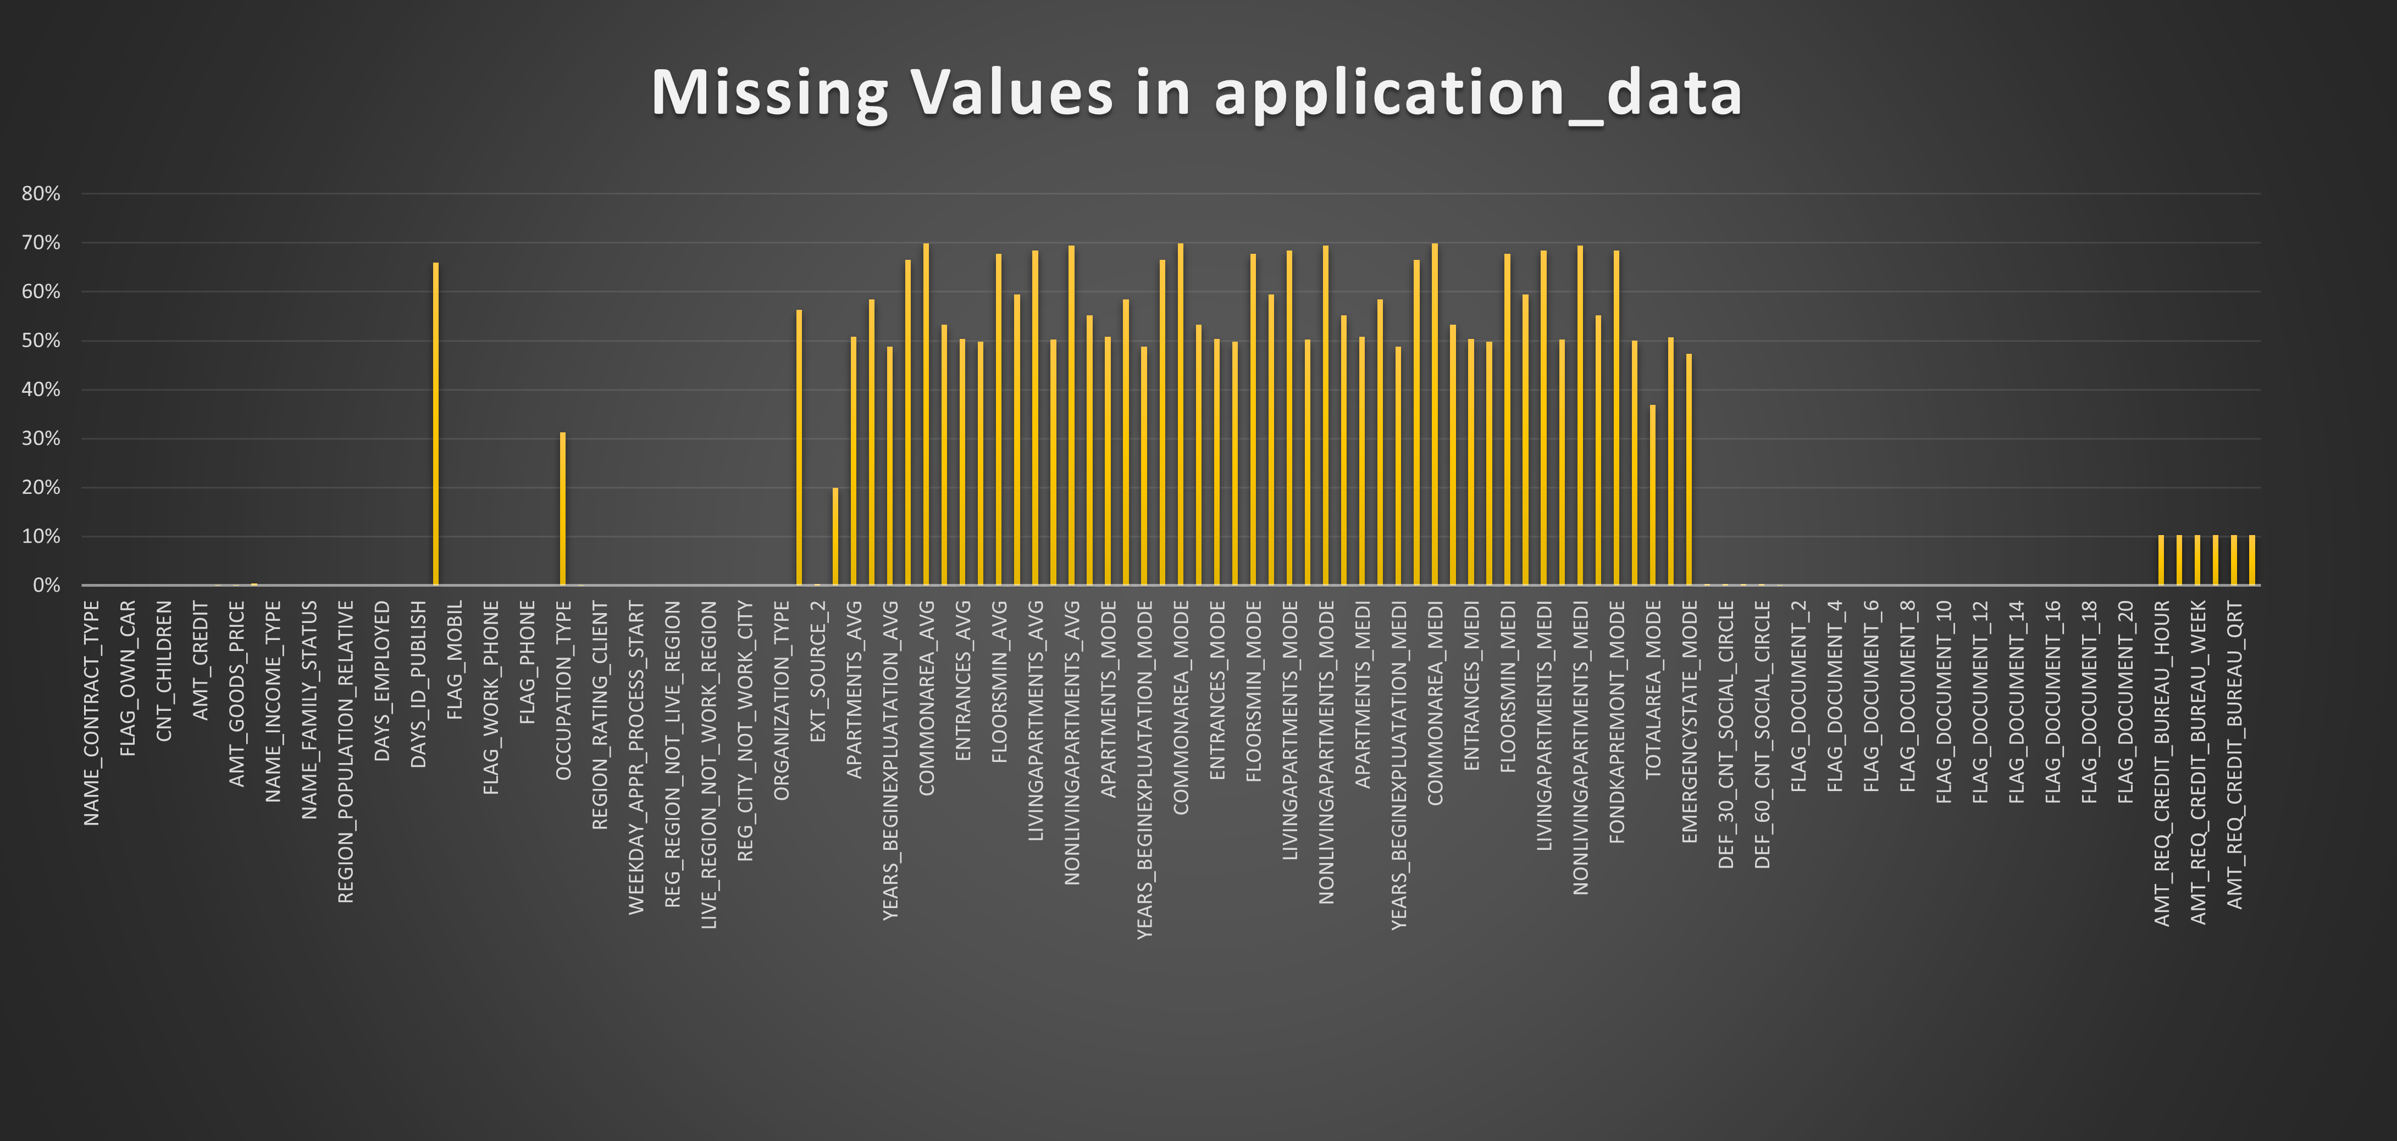
Dataset application_data.csv
No of rows= 49999
No of columns= 122
Used COUNTA() to calculate the percentage of missing values for each column.
Visualized proportion of missing values using clustered column chart .
We will drop the columns which has 40% or more missing values.
Shortened the columns from 122 to 76.

Slide 8
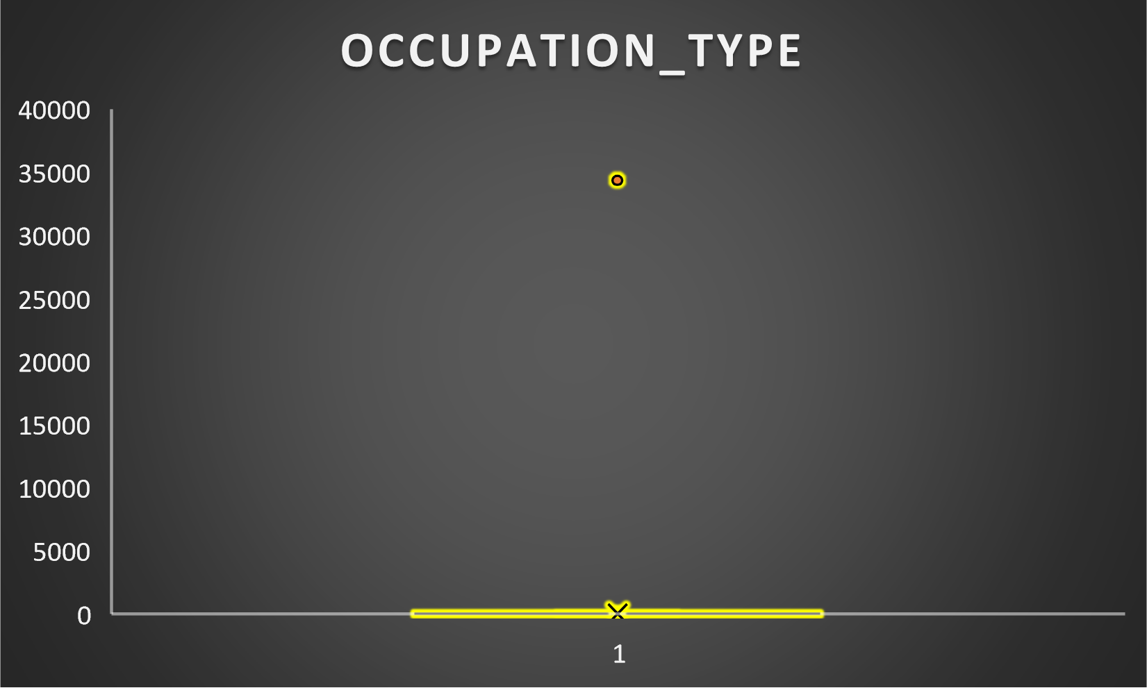
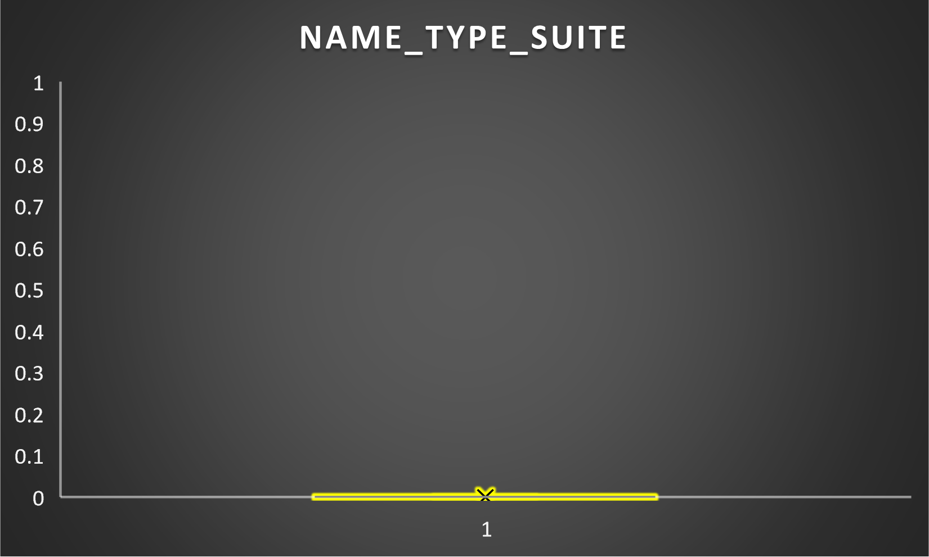
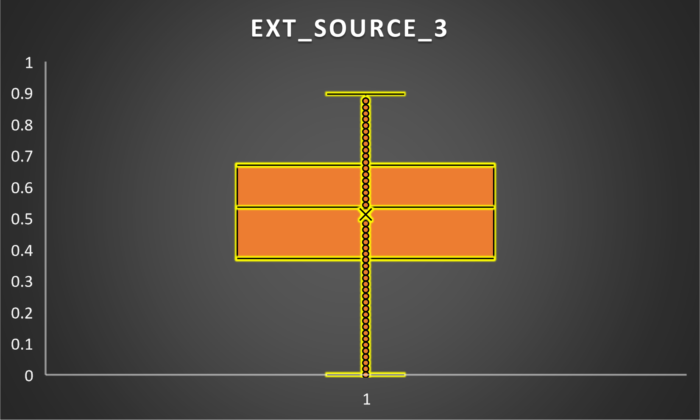
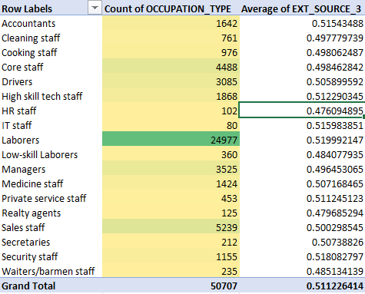
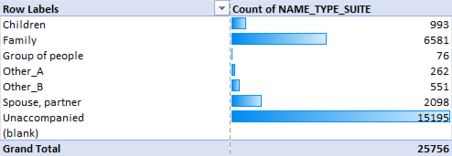
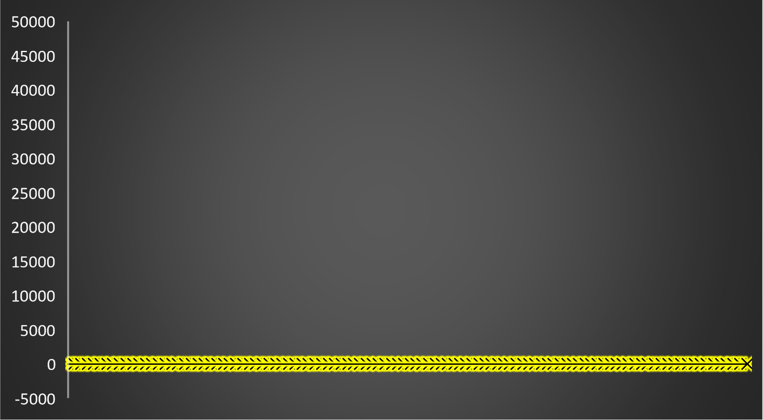
Missing Values Imputation
Since the box plot is not skewed, we can impute the missing values with the mean.
OCCUPATION_TYPE
NAME_TYPE_SUITE
EXT_SOURCE_3
AMT_REQ_CREDIT_BUREAU_HOUR, AMT_REQ_CREDIT_BUREAU_DAY, AMT_REQ_CREDIT_BUREAU_WEEK, AMT_REQ_CREDIT_BUREAU_MON, AMT_REQ_CREDIT_BUREAU_QRT, AMT_REQ_CREDIT_BUREAU_YEAR
We replaced missing values with Unaccompanied since it has the highest count.
Since, Laborers have the most count, we replaced all missing values with it.
We replaced missing values in EXT_SOURCE_3, AMT_REQ_CREDIT_BUREAU_HOUR, AMT_REQ_CREDIT_BUREAU_DAY, AMT_REQ_CREDIT_BUREAU_WEEK, AMT_REQ_CREDIT_BUREAU_MON, AMT_REQ_CREDIT_BUREAU_QRT and AMT_REQ_CREDIT_BUREAU_YEAR
with its mean.

Slide 9
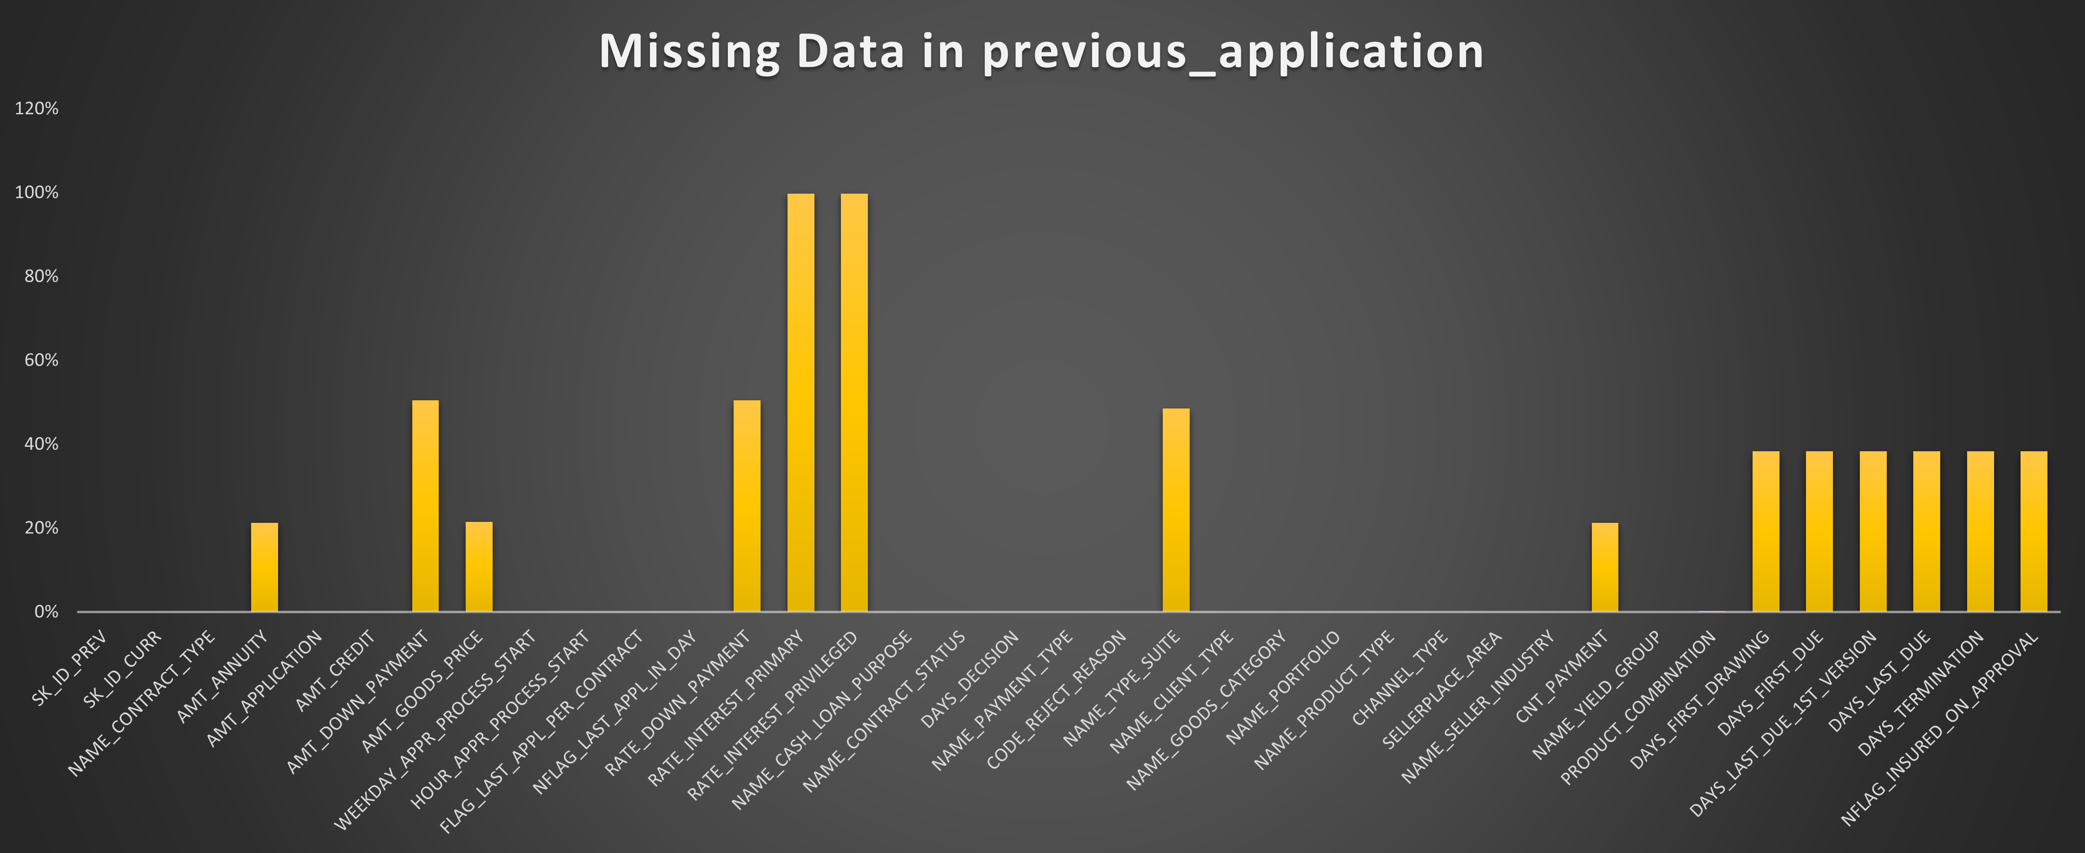
Dataset previous_data.csv
No of rows= 49999
No of columns= 37
Used COUNTA() to calculate the percentage of missing values for each column.
Visualized proportion of missing values using clustered column chart .
We will drop the columns which has 40% or more missing values.
Shortened the columns from 37 to 32.

Slide 10
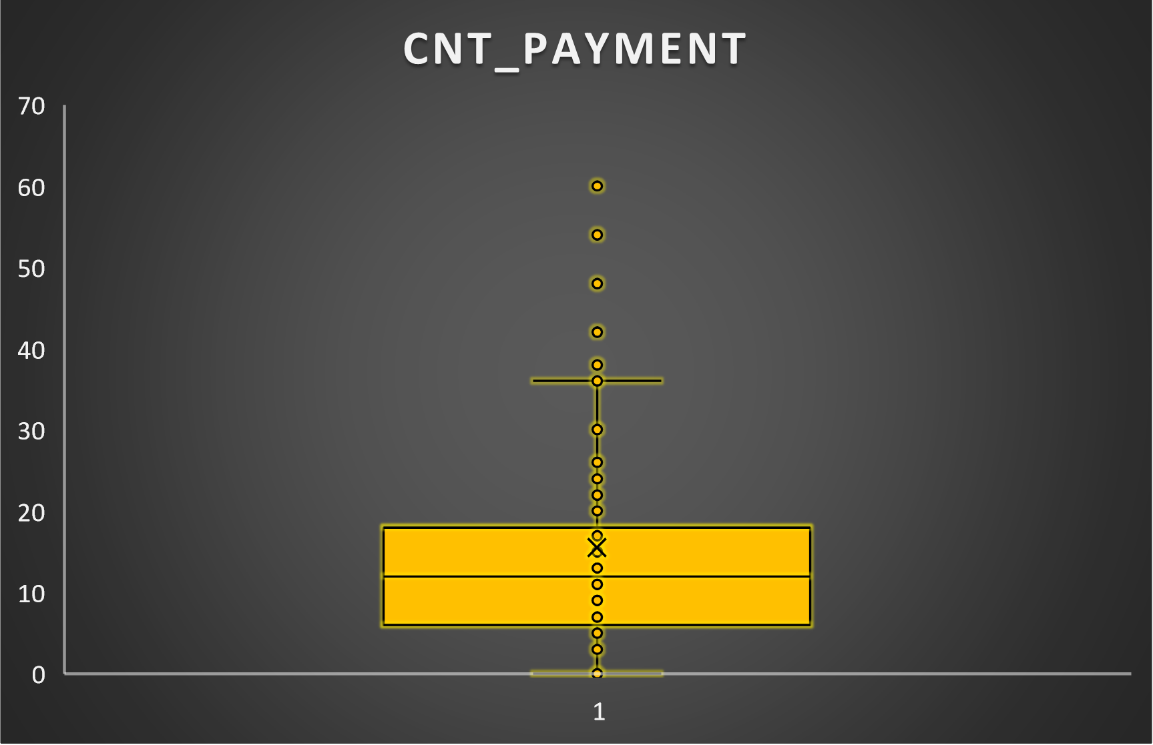
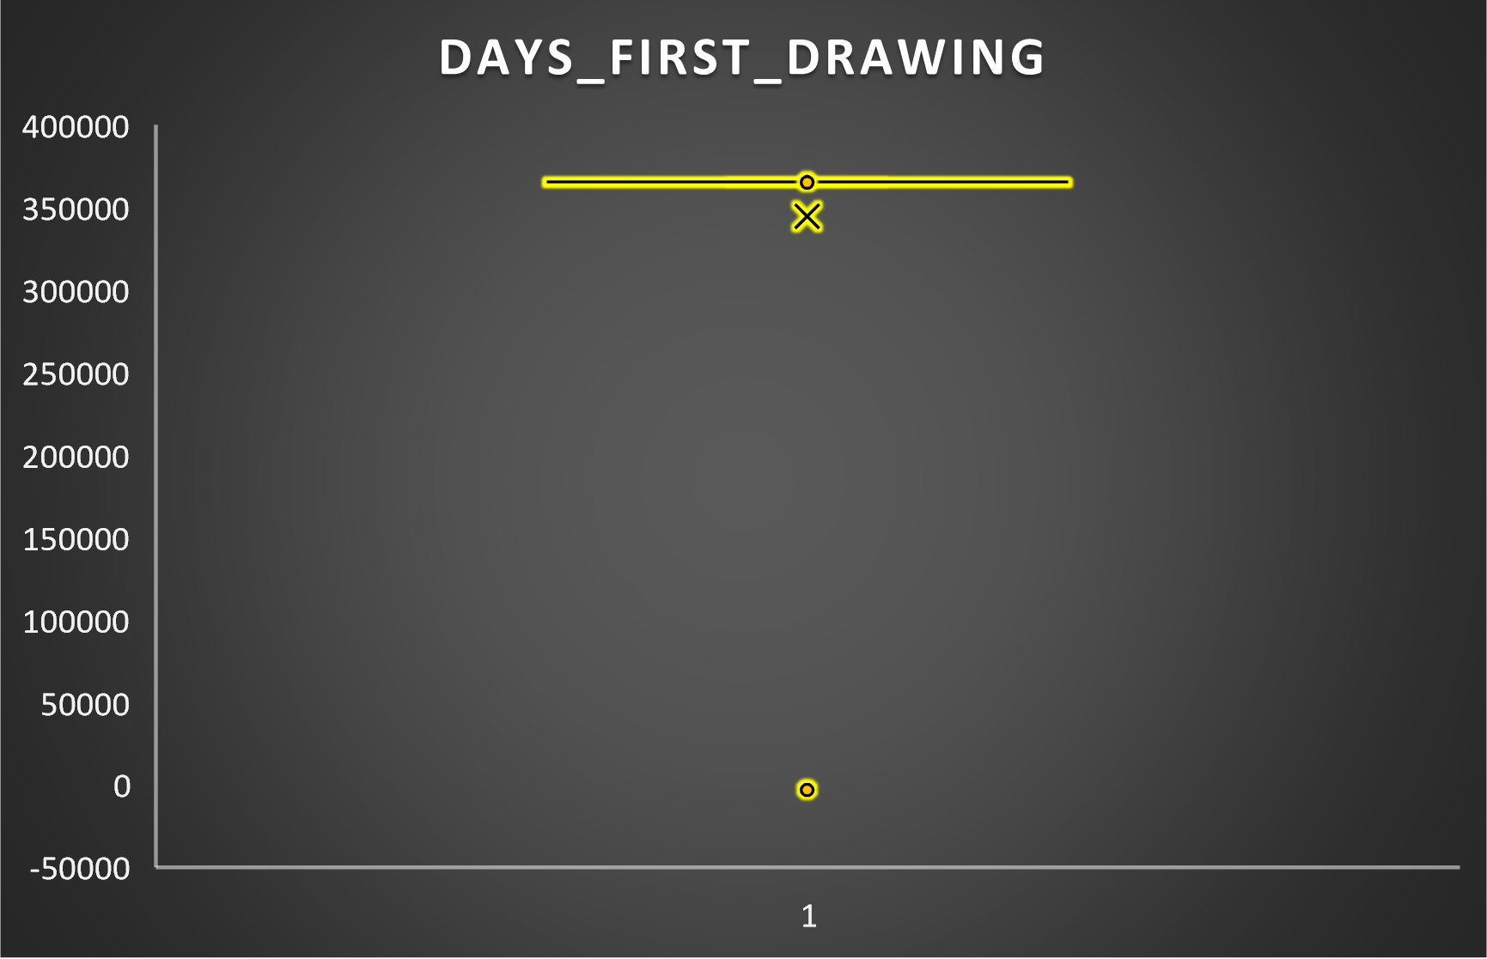
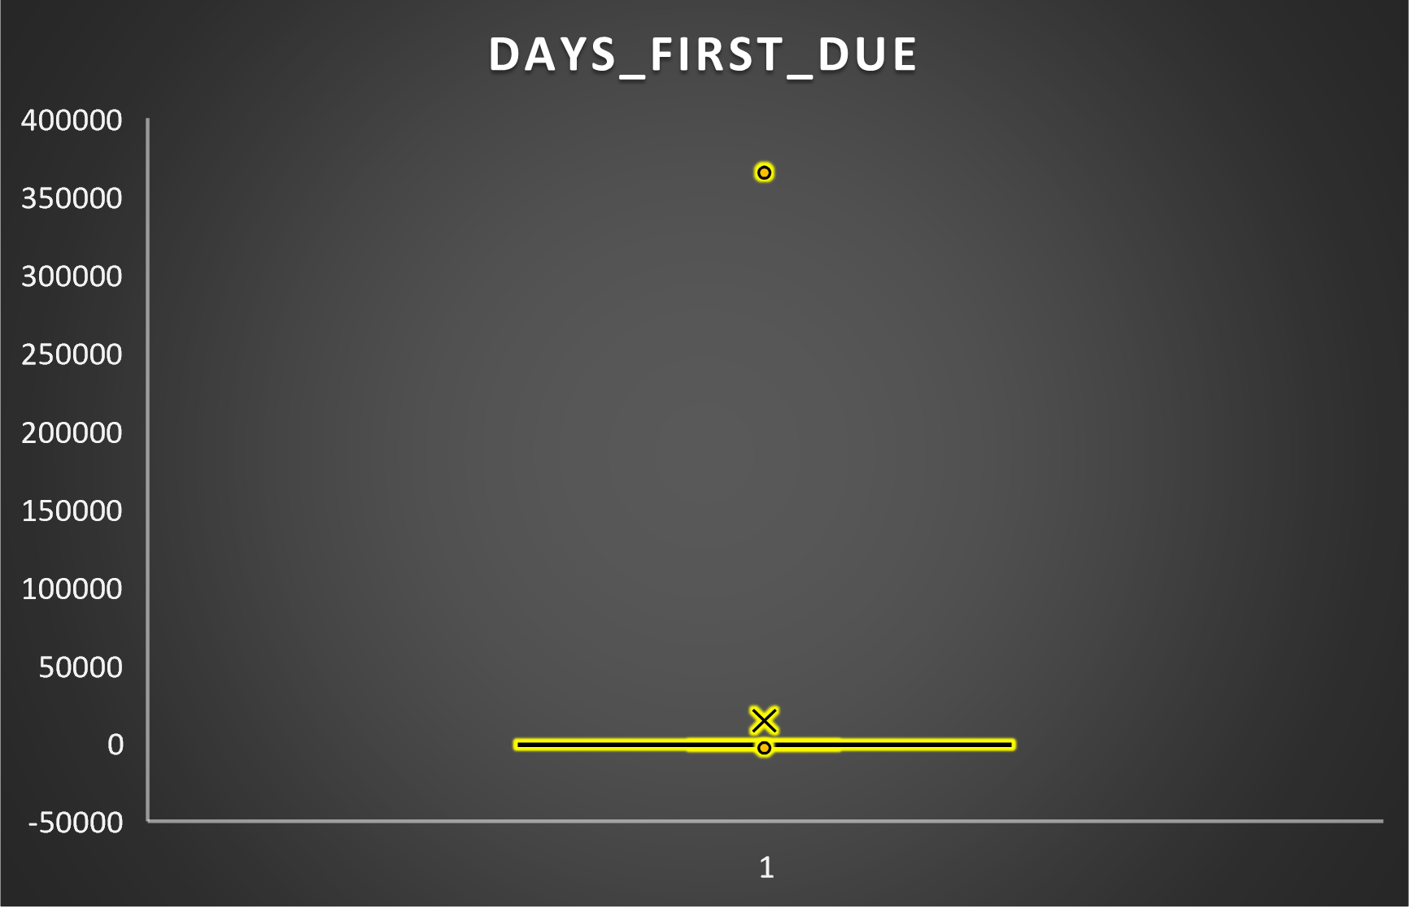
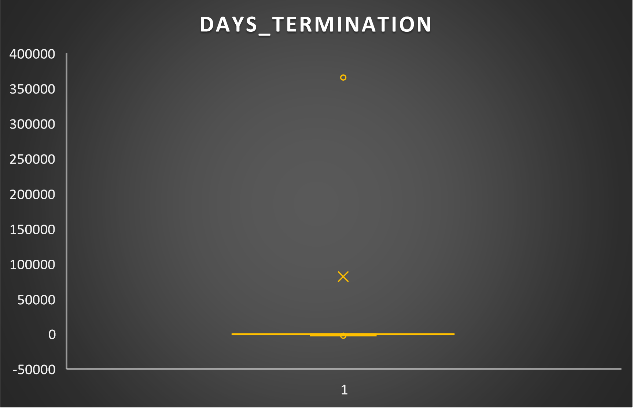
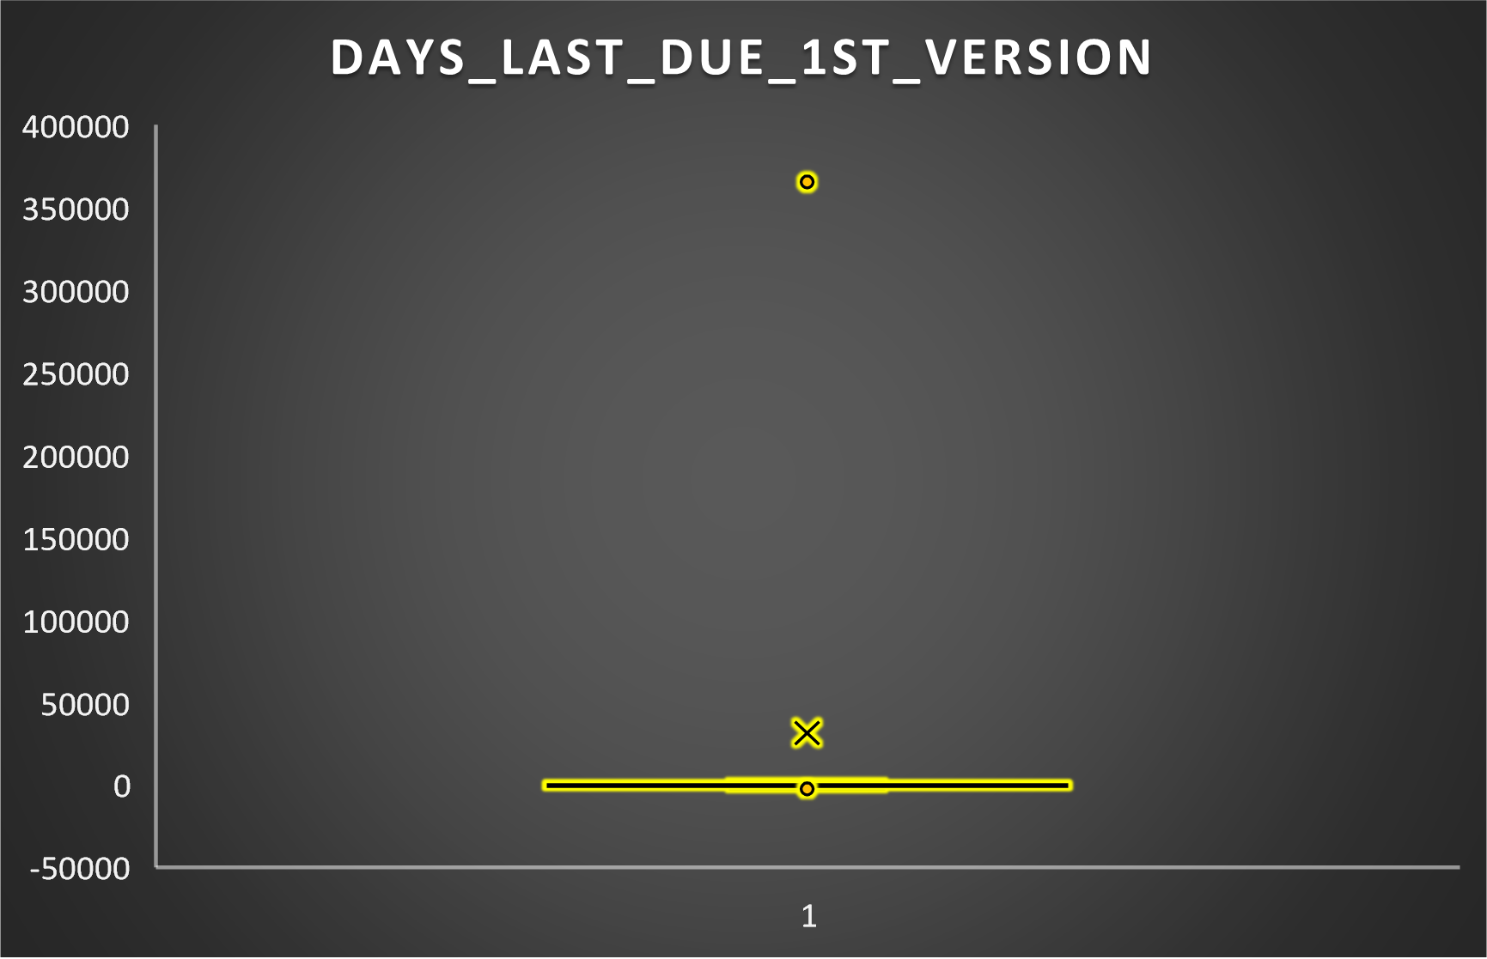
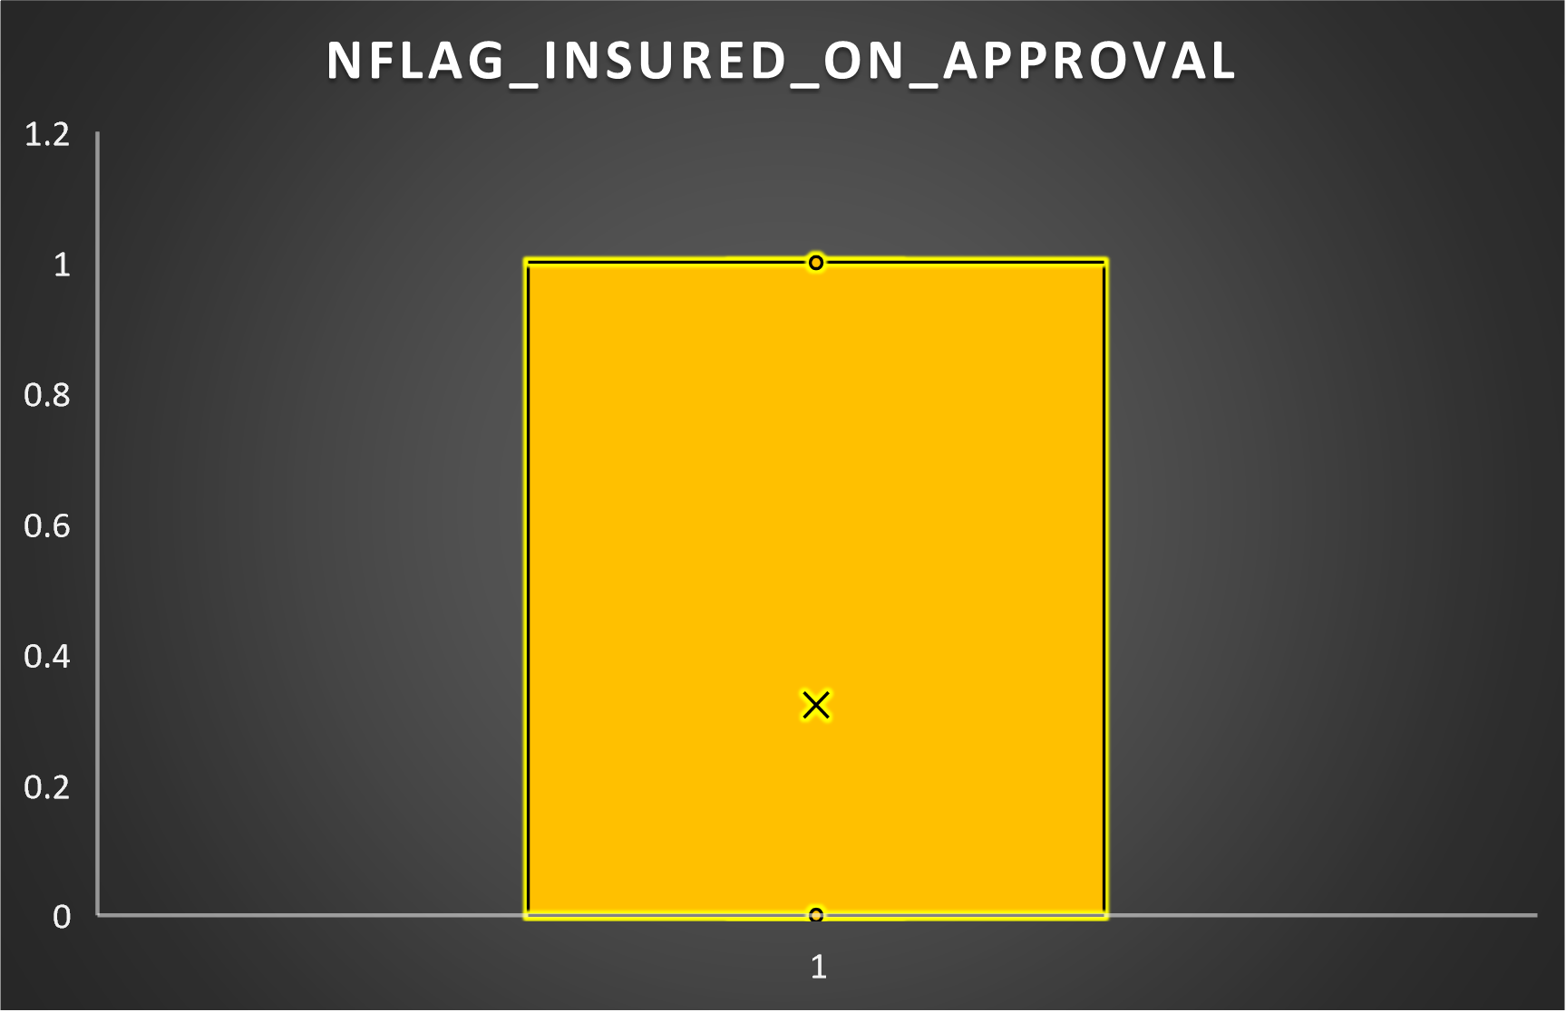
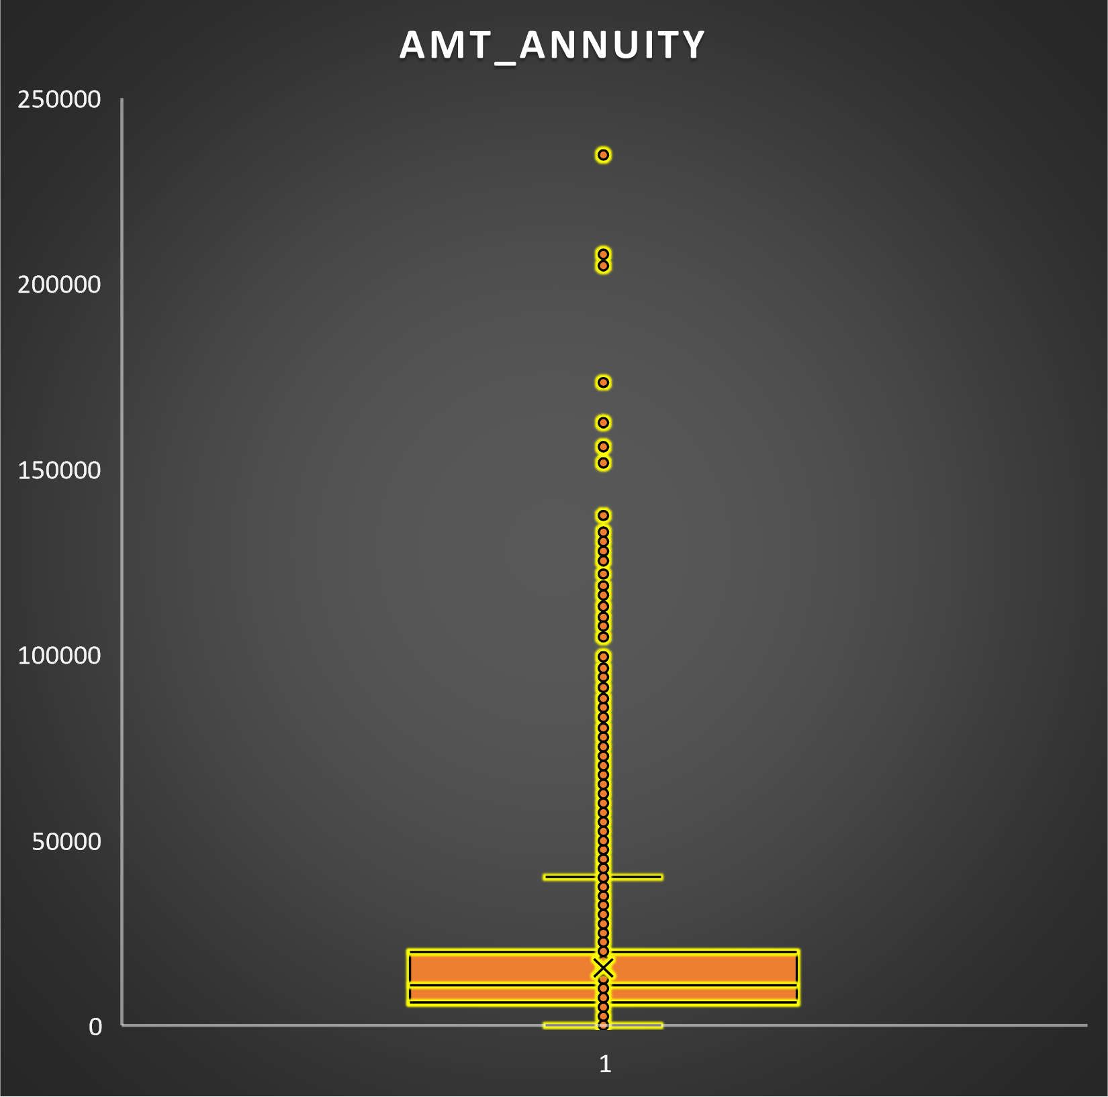
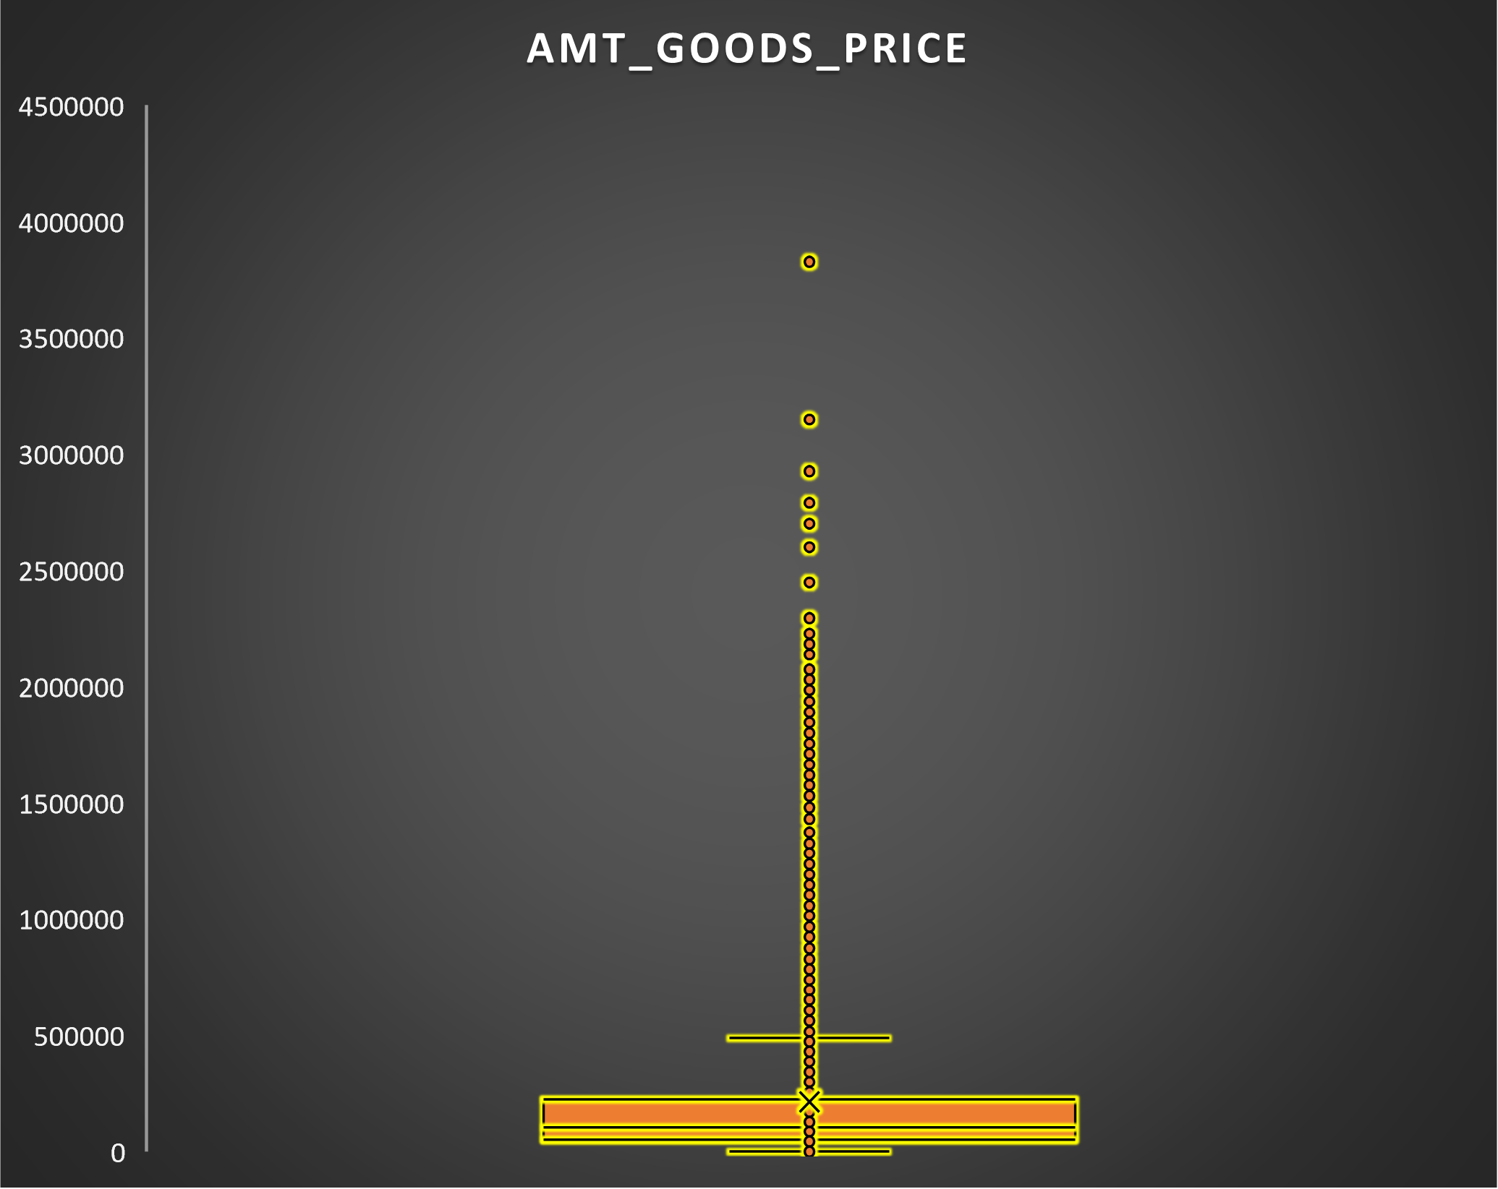
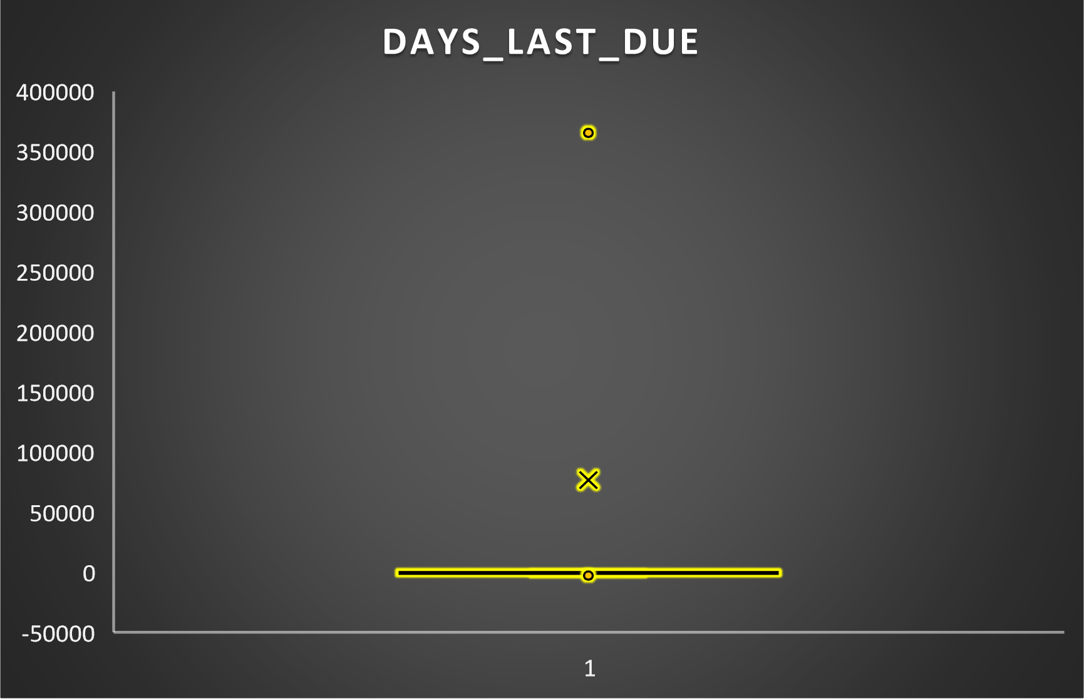
Missing Values Imputation
For variables which have skewedness, we replaced the missing values with median and for non-skewed, the missing values are replaced with mean.
NFLAG_INSURED_ON_APPROVAL is replaced with mode .
AMT_ANNUNITY,AMT_GOODS, CNT_PAYMENT is replaced with mean/average.
DAYS_LAST_DUE_1st_VERSION,DAYS_TERMINATION,DAYS_FIRST_DRAWING,DAYS_FIRST_DUE are replaced with median values.

Slide 11
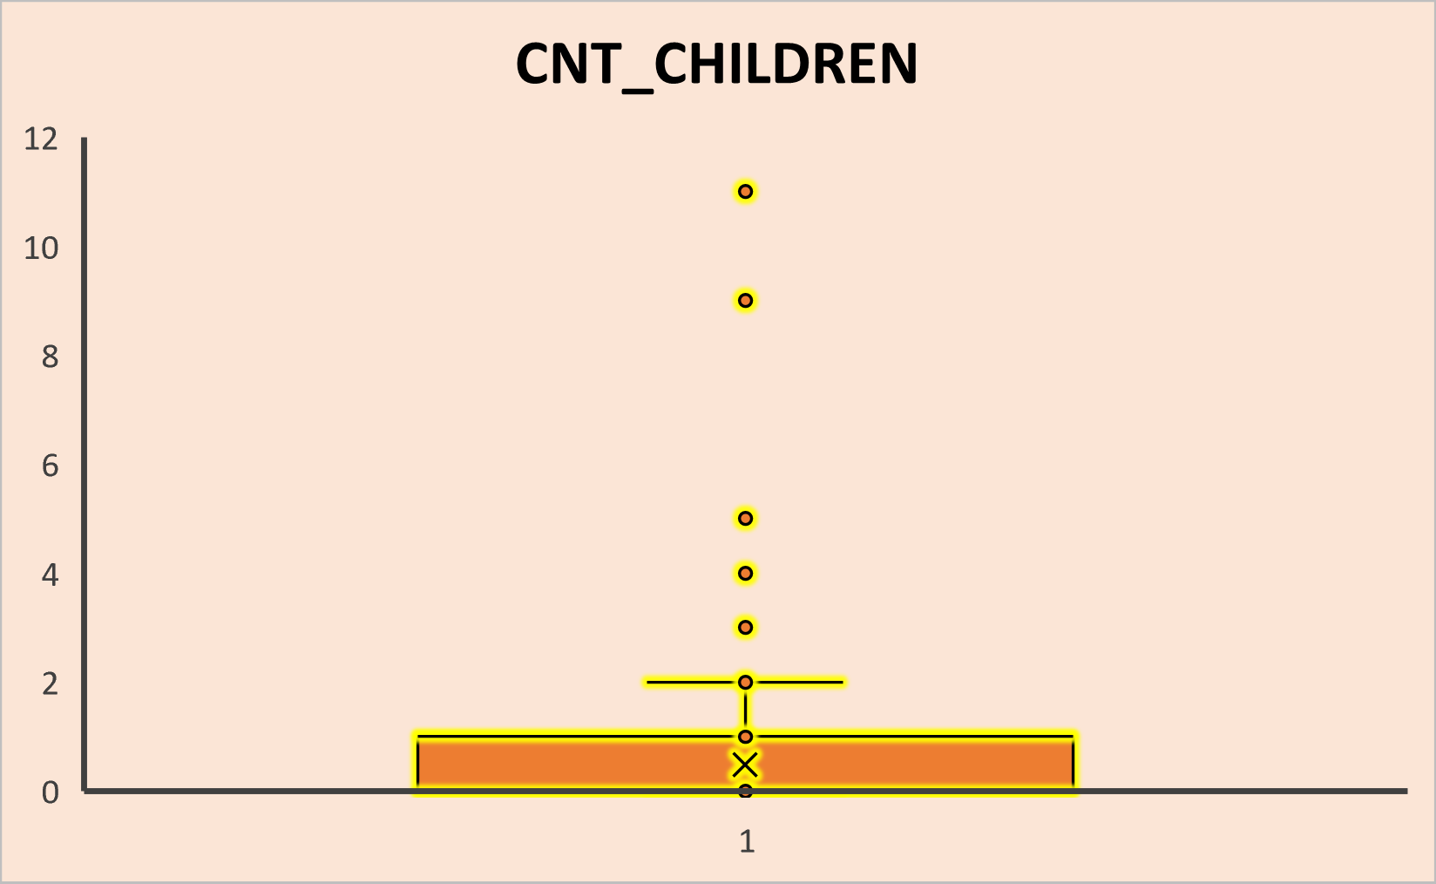
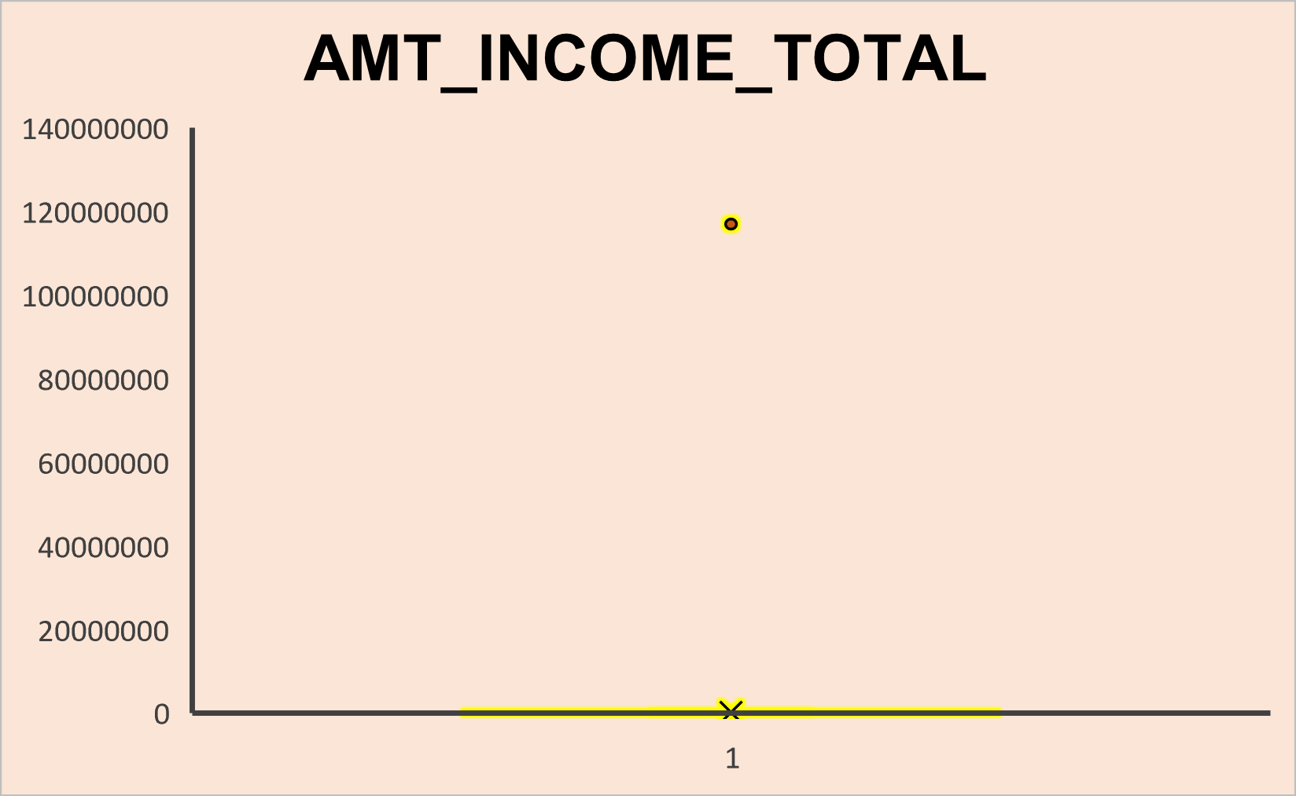
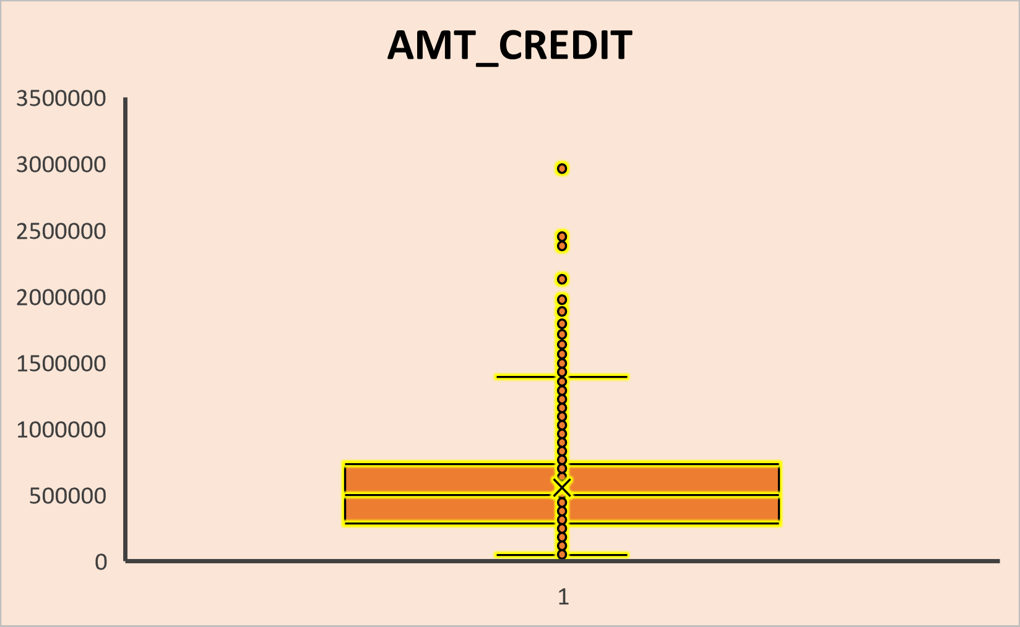
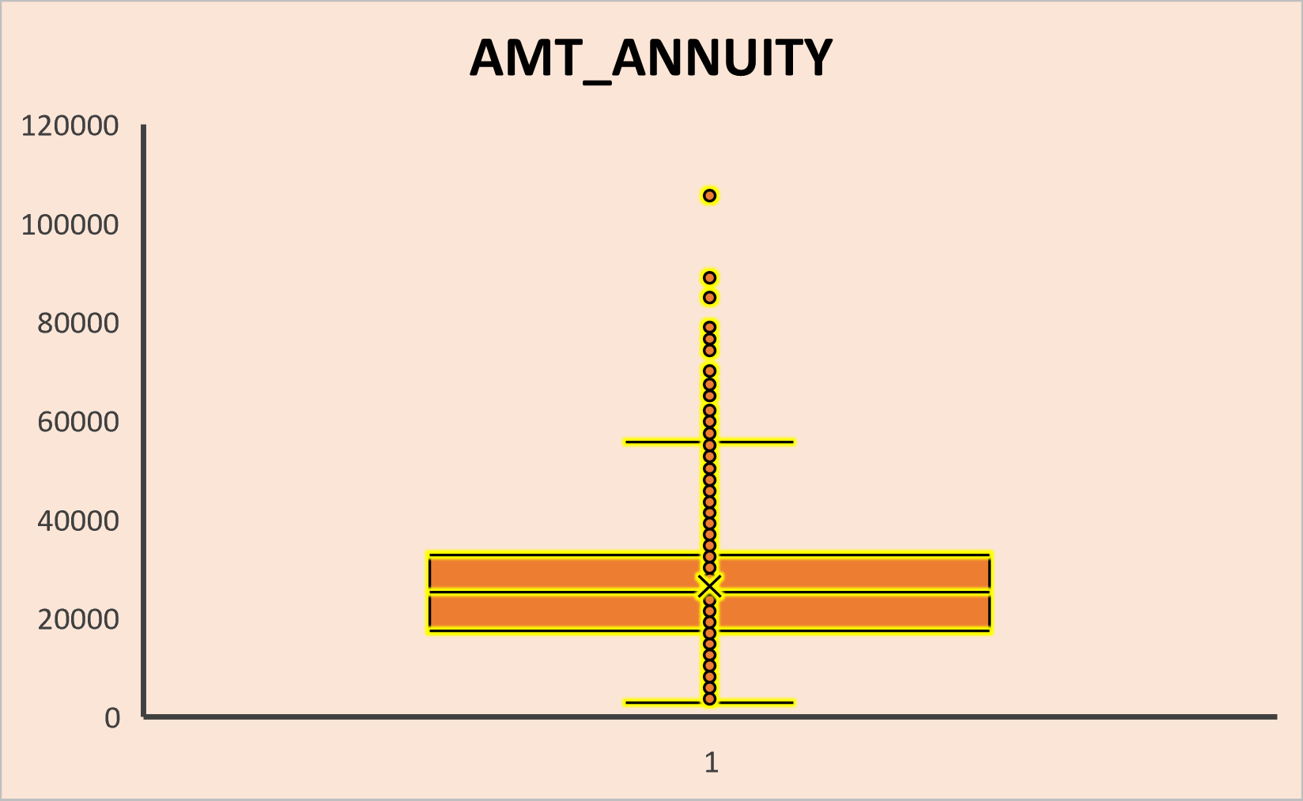
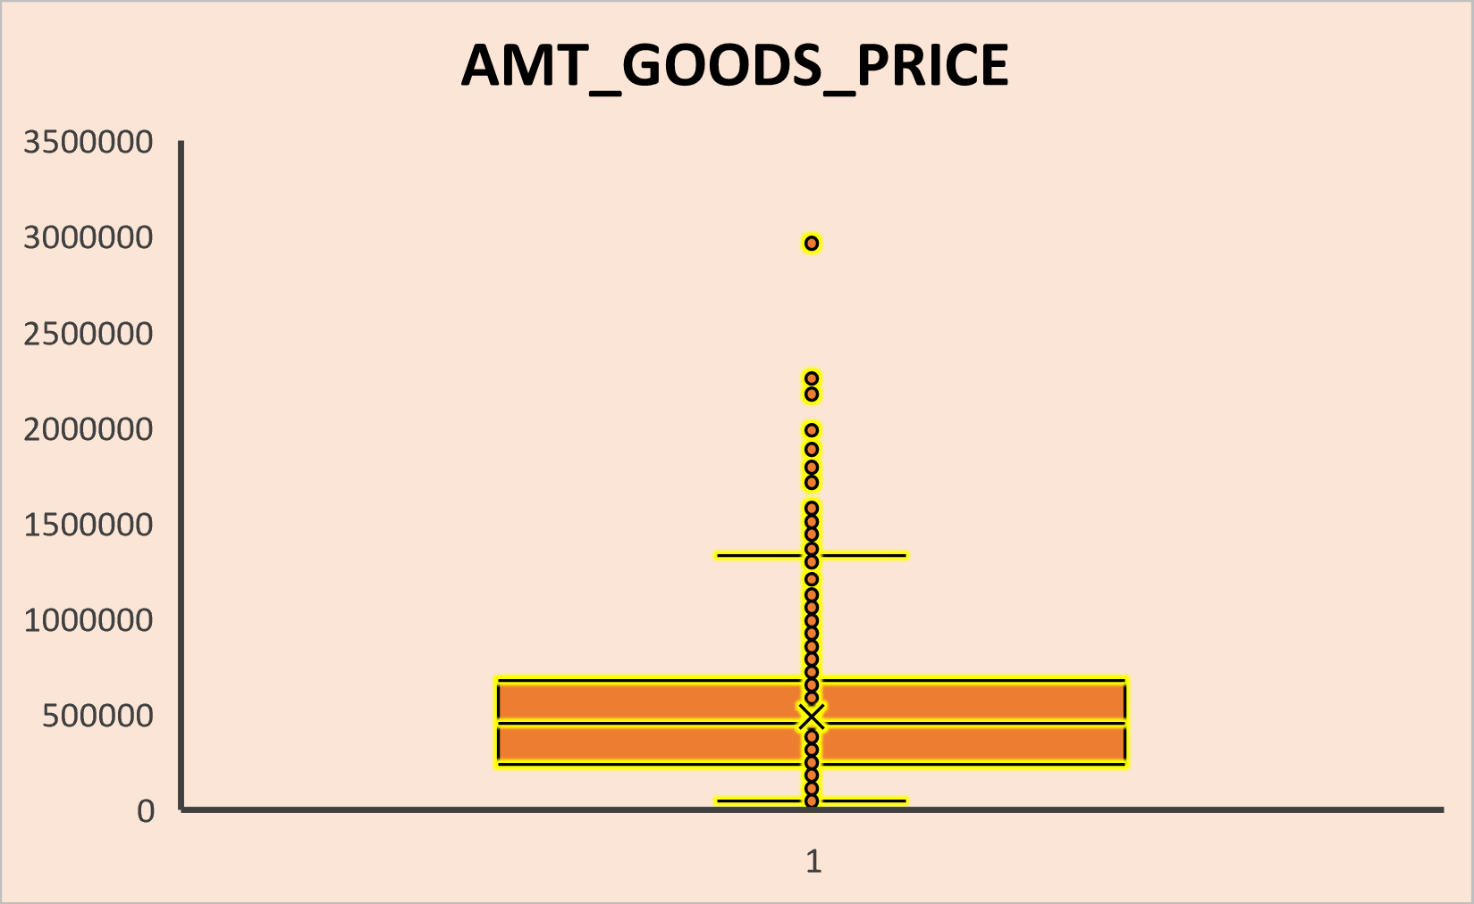
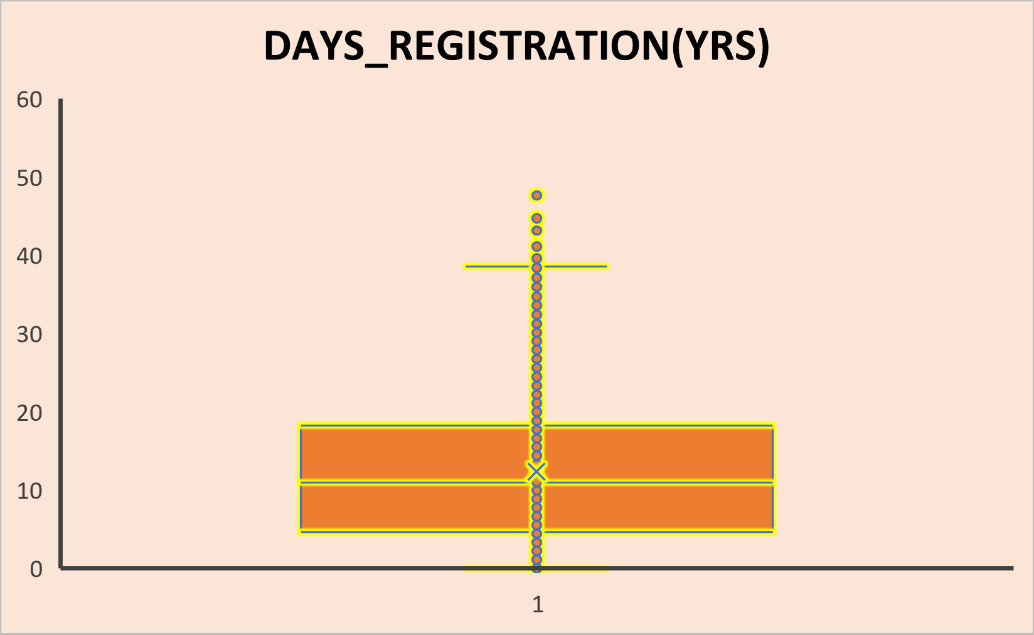
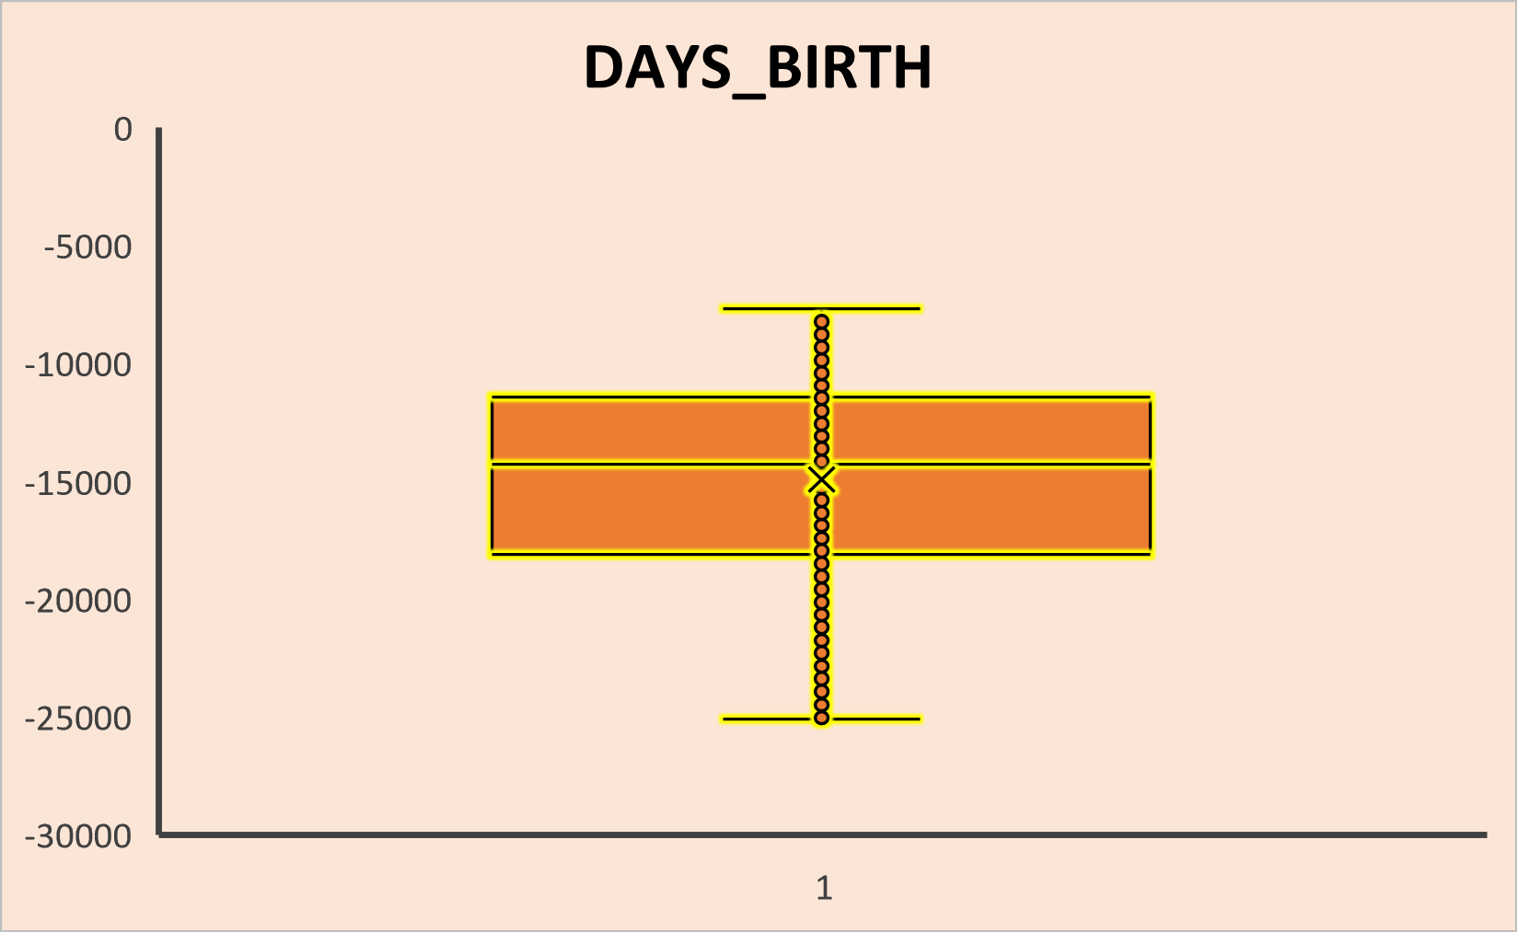
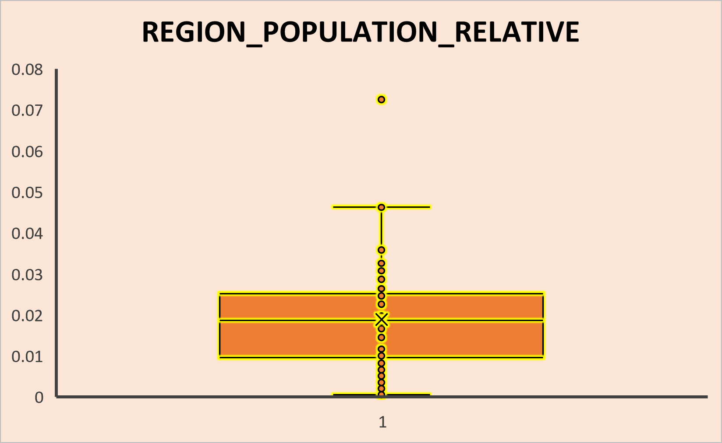
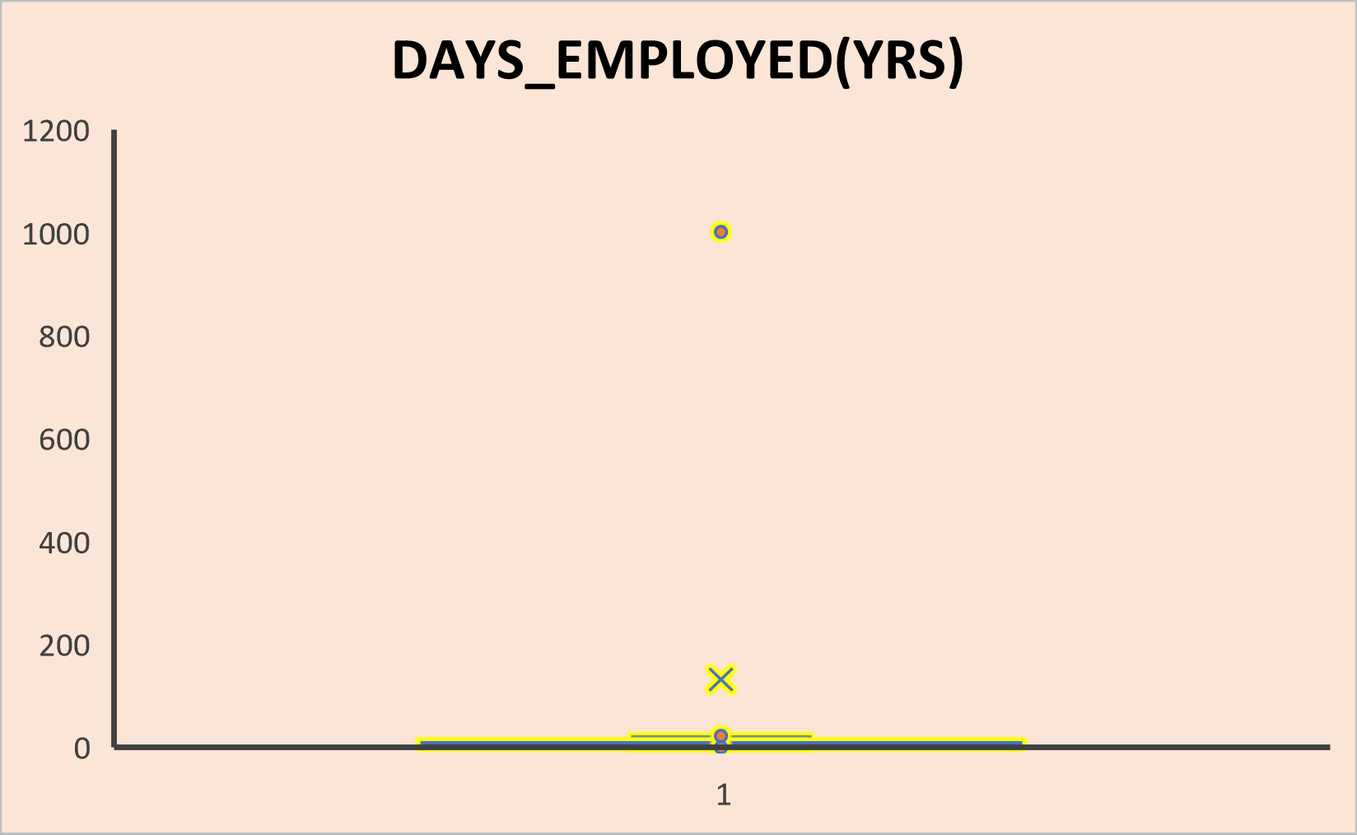
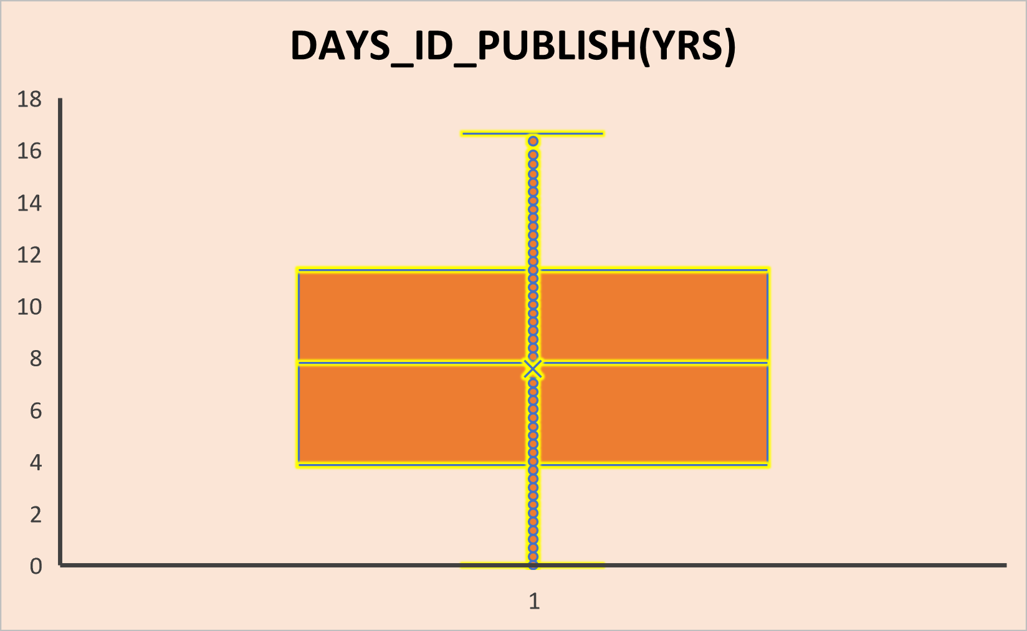
B. Identify OUTLIERS in the Dataset
Dataset application_data.csv
CNT_CHILDREN has values 11 and 9, which is practically not possible in today’s time.
AMT_INCOME_TOTAL has a outlier 117000000.
AMT_CREDIT has a outlier 2961000,2447937,2377431,2125943, etc.
AMT_ANNUNITY has a outlier 105511.5 and few more values.
AMT_GOODS_PRICE has outliers 2961000 and some more values.
DAYS_REGISTRATION(YRS),DAYS_EMPLOYED(YRS) have some outliers.
REGION_POPULATION_RELATIVE,DAYS_BIRTH,DAYS_ID(YRS) have no outlier values.

Slide 12
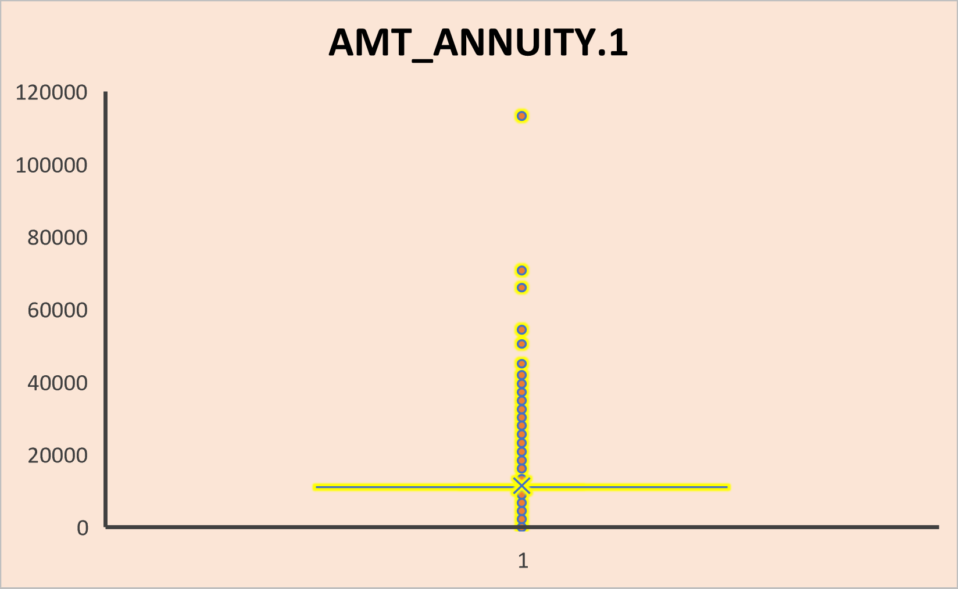
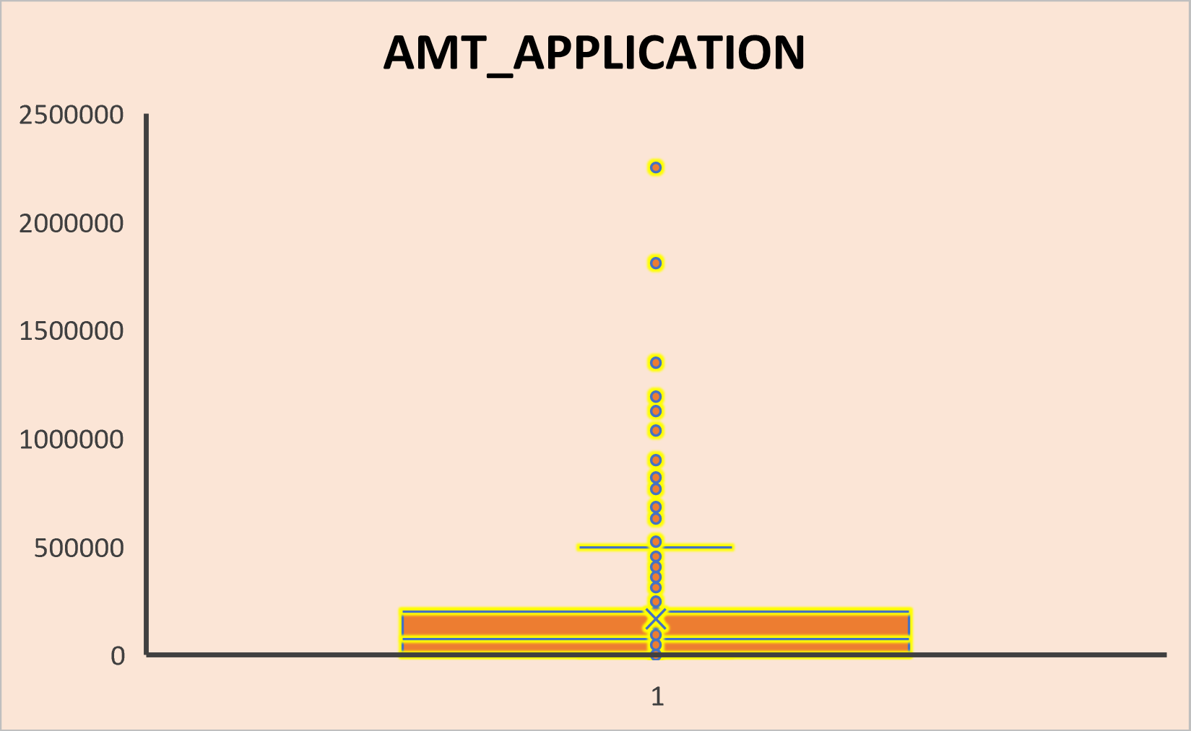
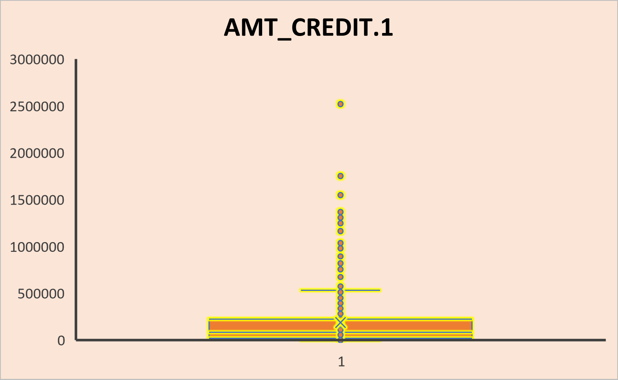
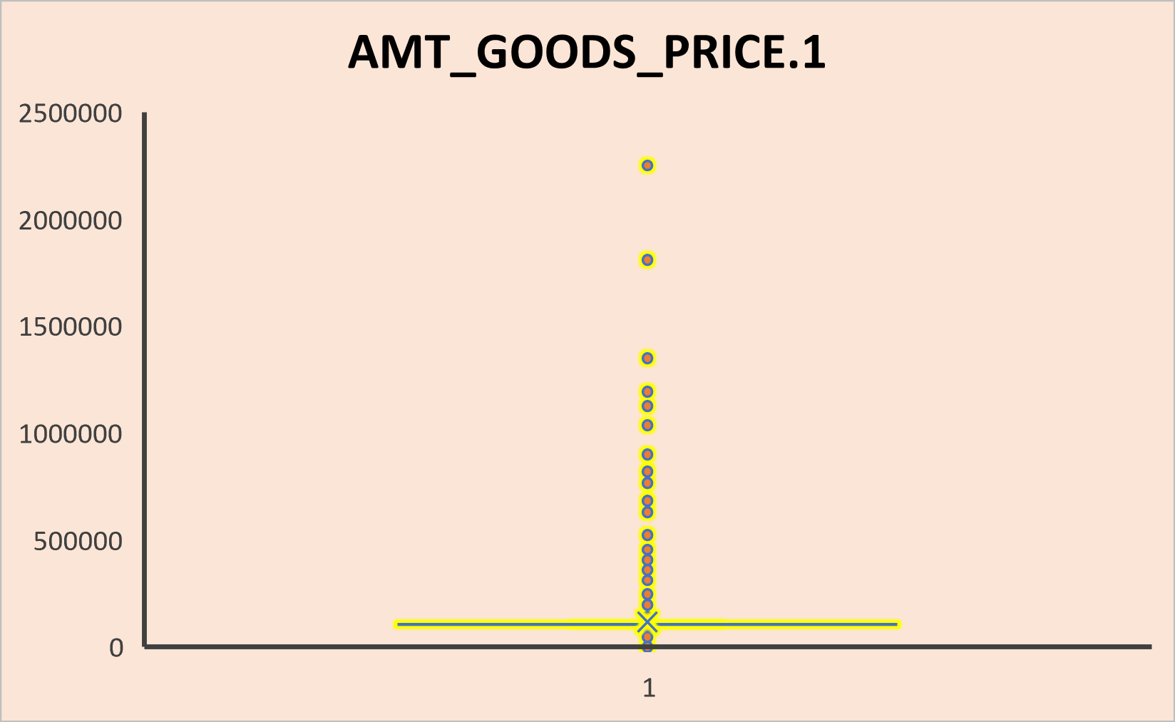
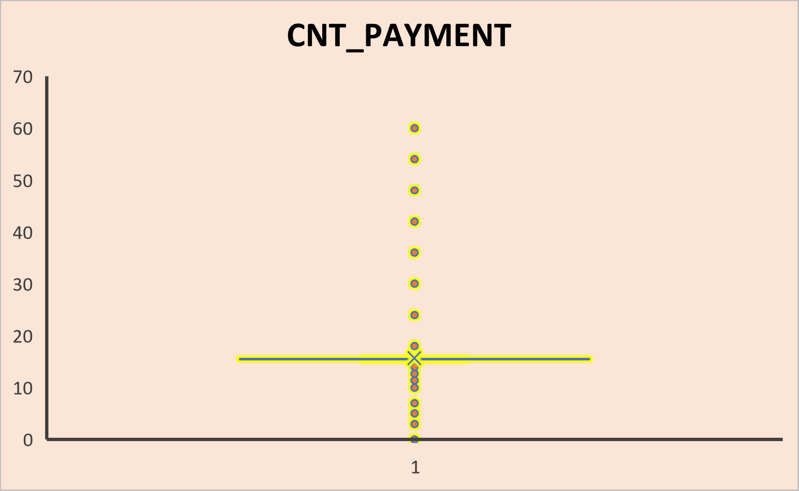
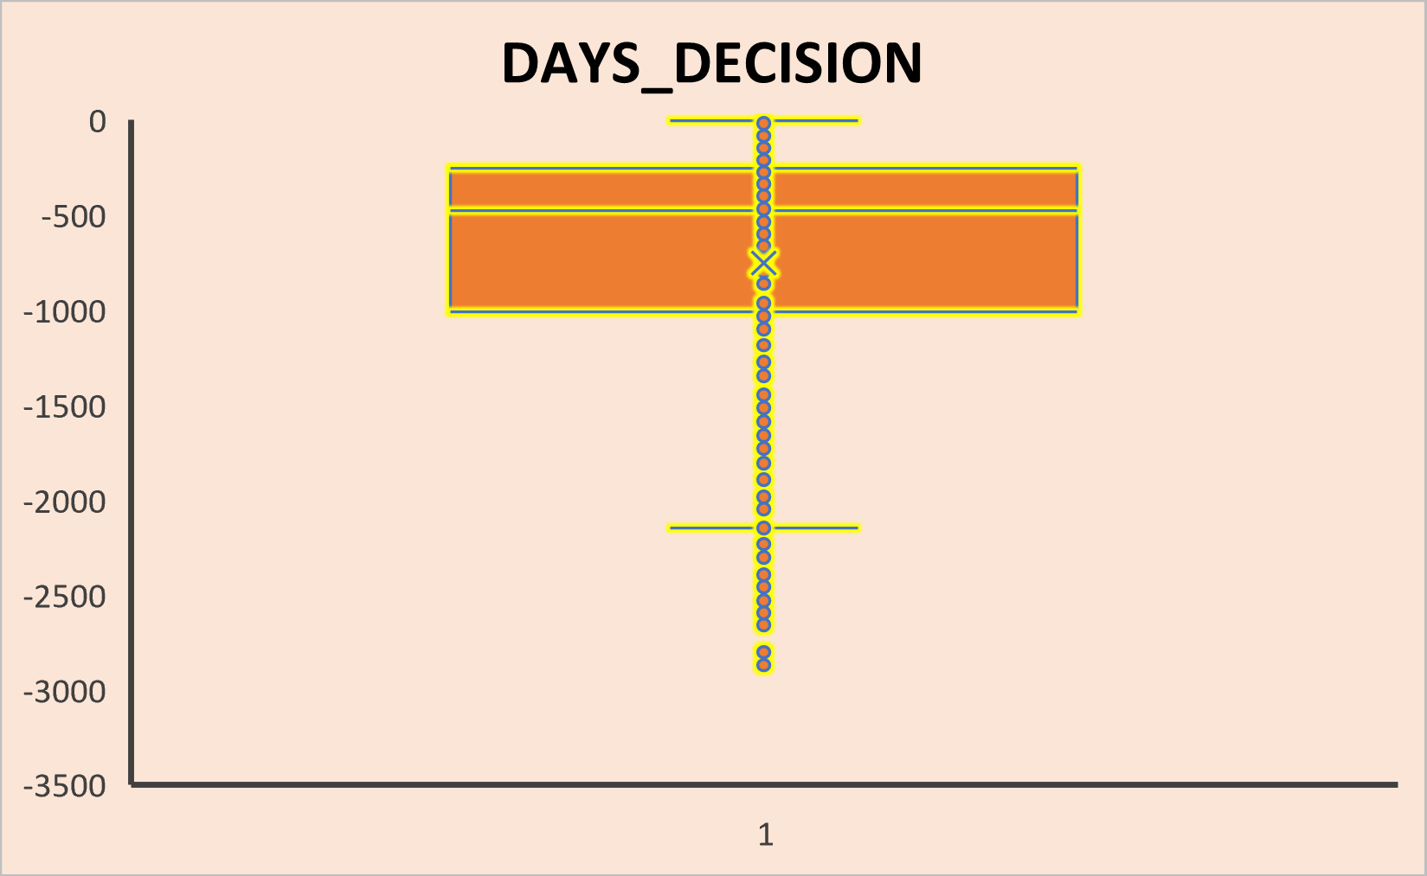
Dataset previous_data.csv
We observe that AMT_ANNUNITY,AMT_APPLICATION,AMT_CREDIT,AMT_GOODS_PRICE has huge number of outliers.
DAYS_DECISION also has some outliers which shows that the decisions on them were taken recently.
CNT_PAYMENT has few outliers present.

Slide 13
Now the datasets, application_data and previous_application are both merged into one.
Also, we did feature engineering and created 4 new columns, DAYS_EMPLOYED(YRS), DAYS_REGISTRATION(YRS), DAYS_ID_PUBLISH(YRS), YEARS_BIRTH by dividing the number of days by 365 and taking it’s absolute value, since the column has negative values.
Merging the Datasets

Slide 14
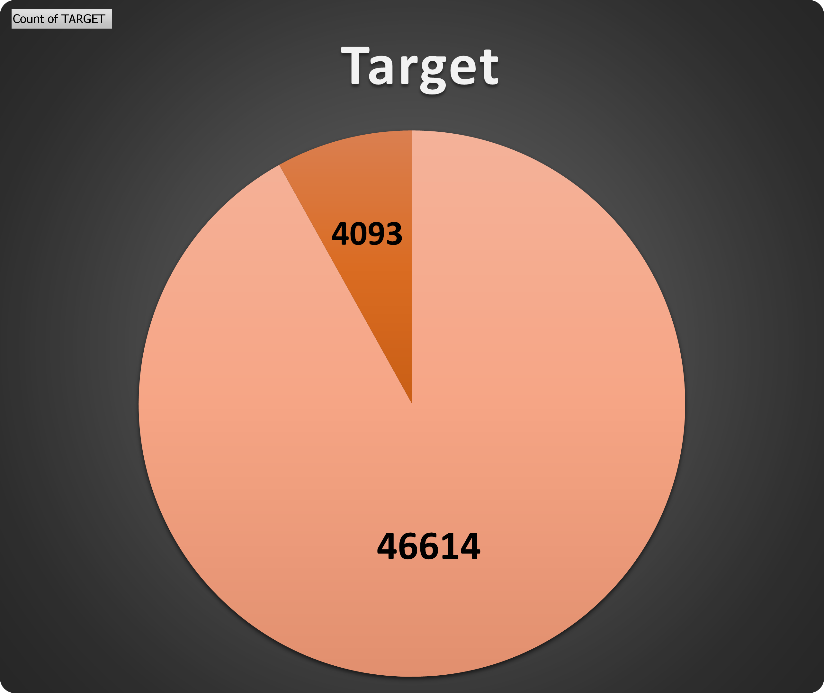
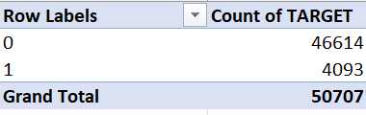
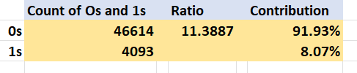
C. Analyze Data Imbalance
1 - Customers with payment difficulties
0 - All other cases.
From the pie chart, we clearly see the imbalance in the data.

Slide 15
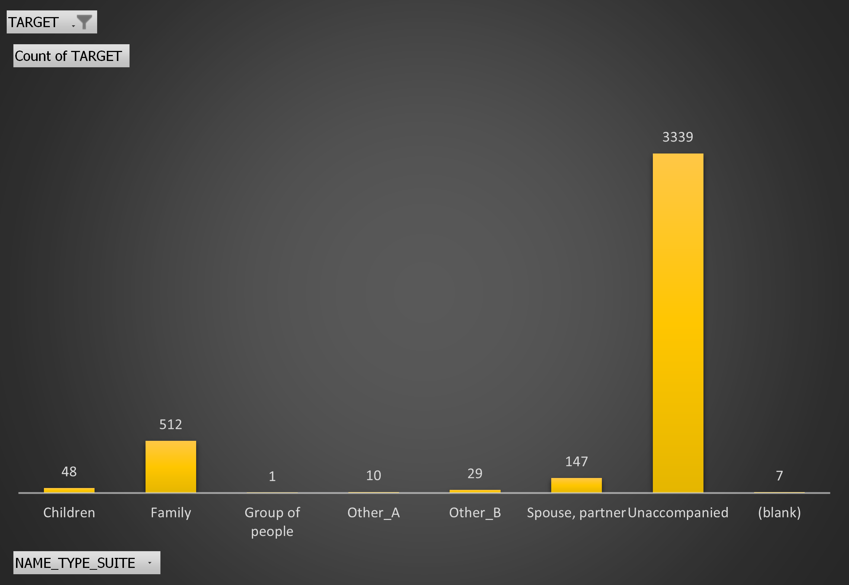
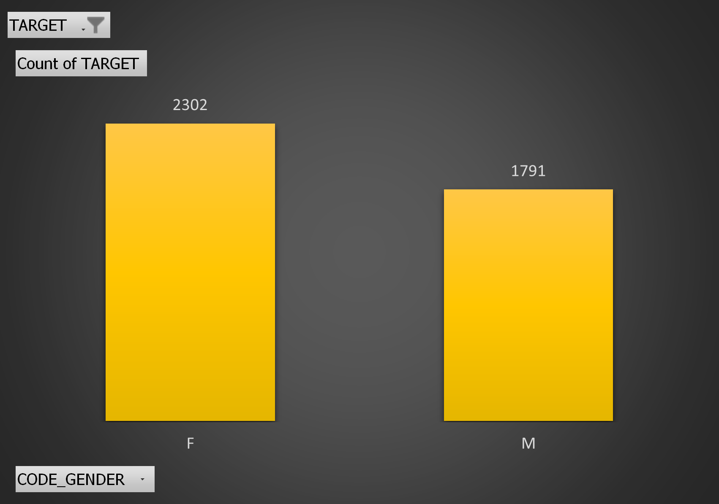
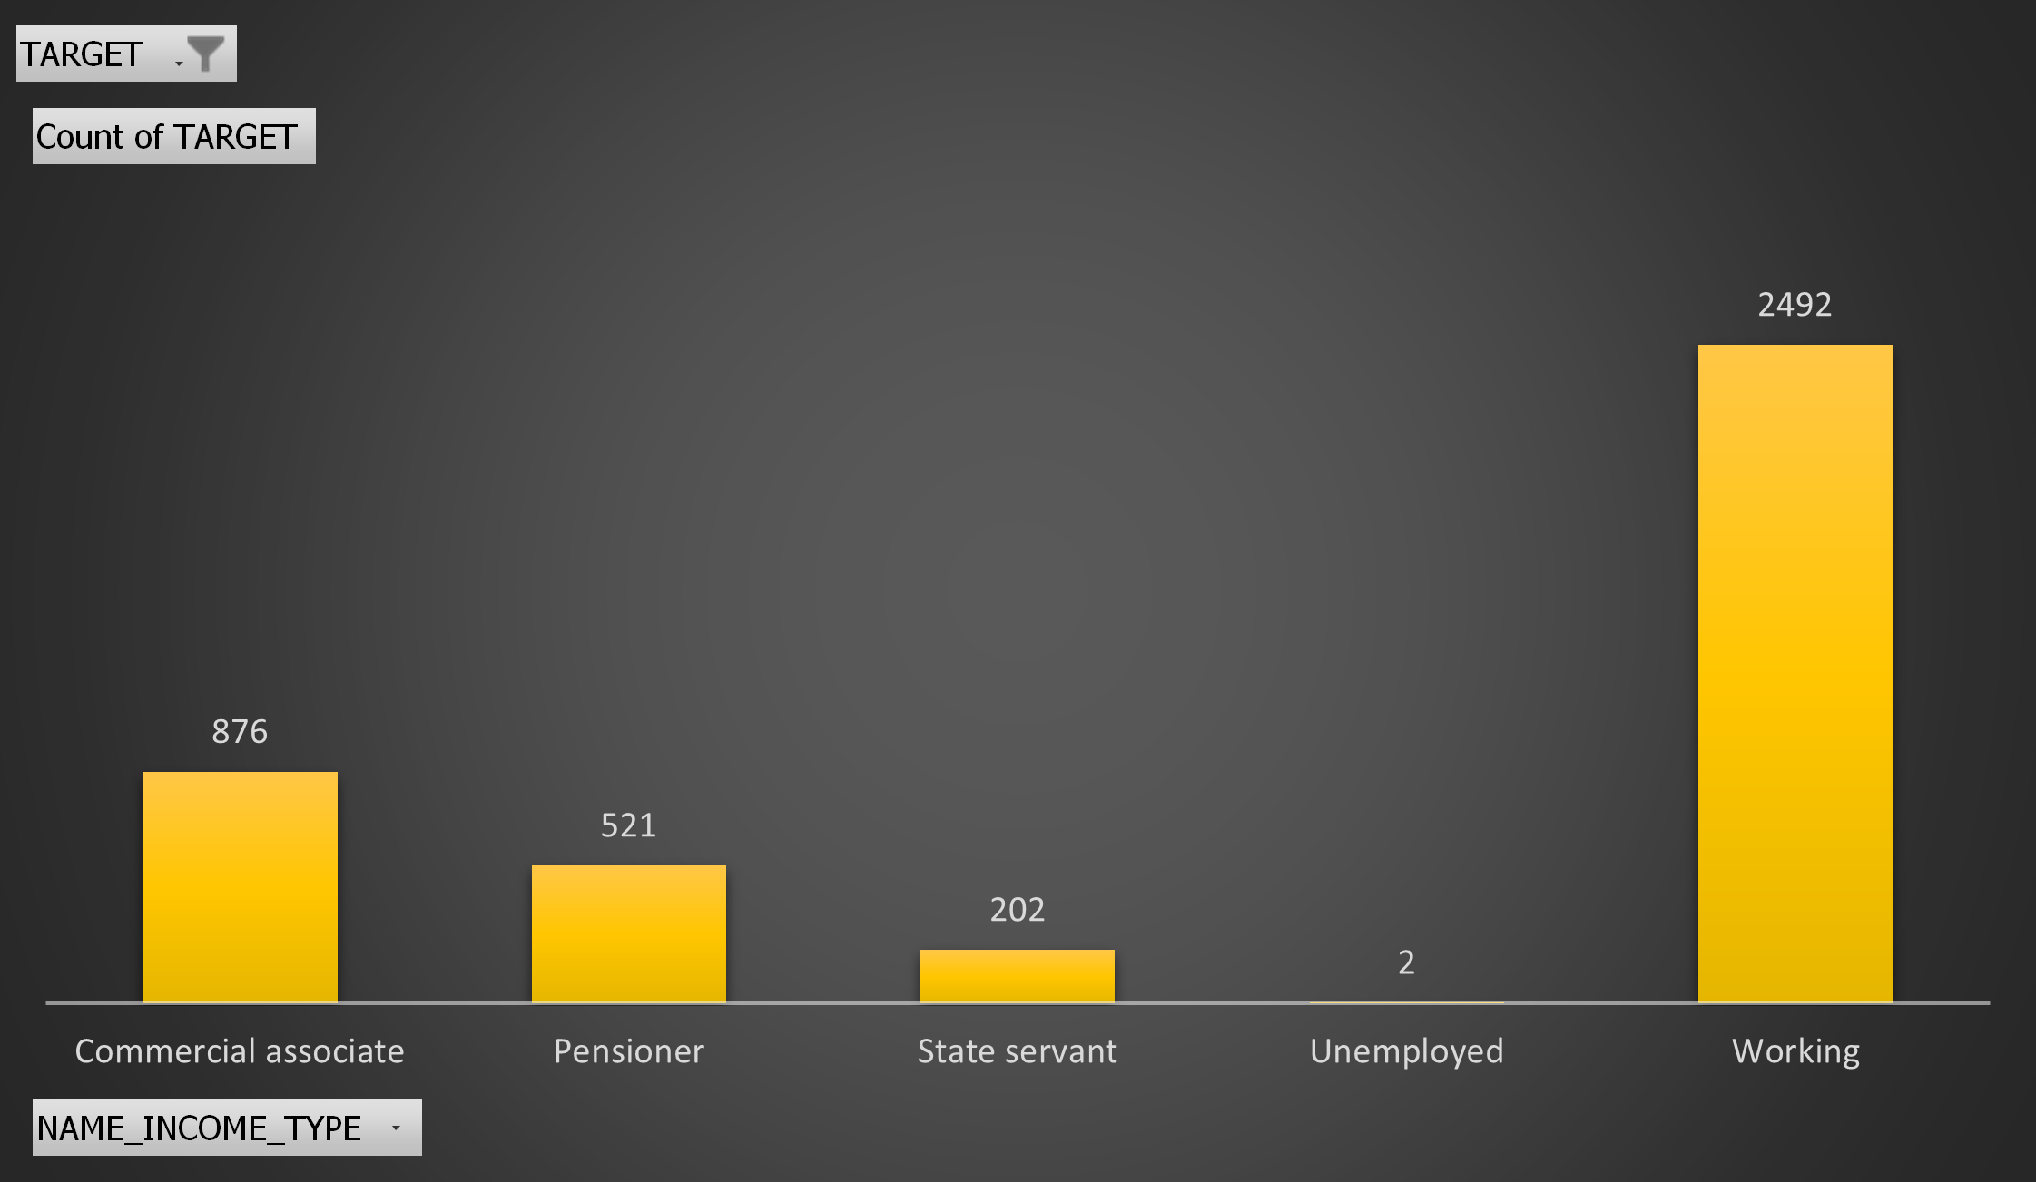
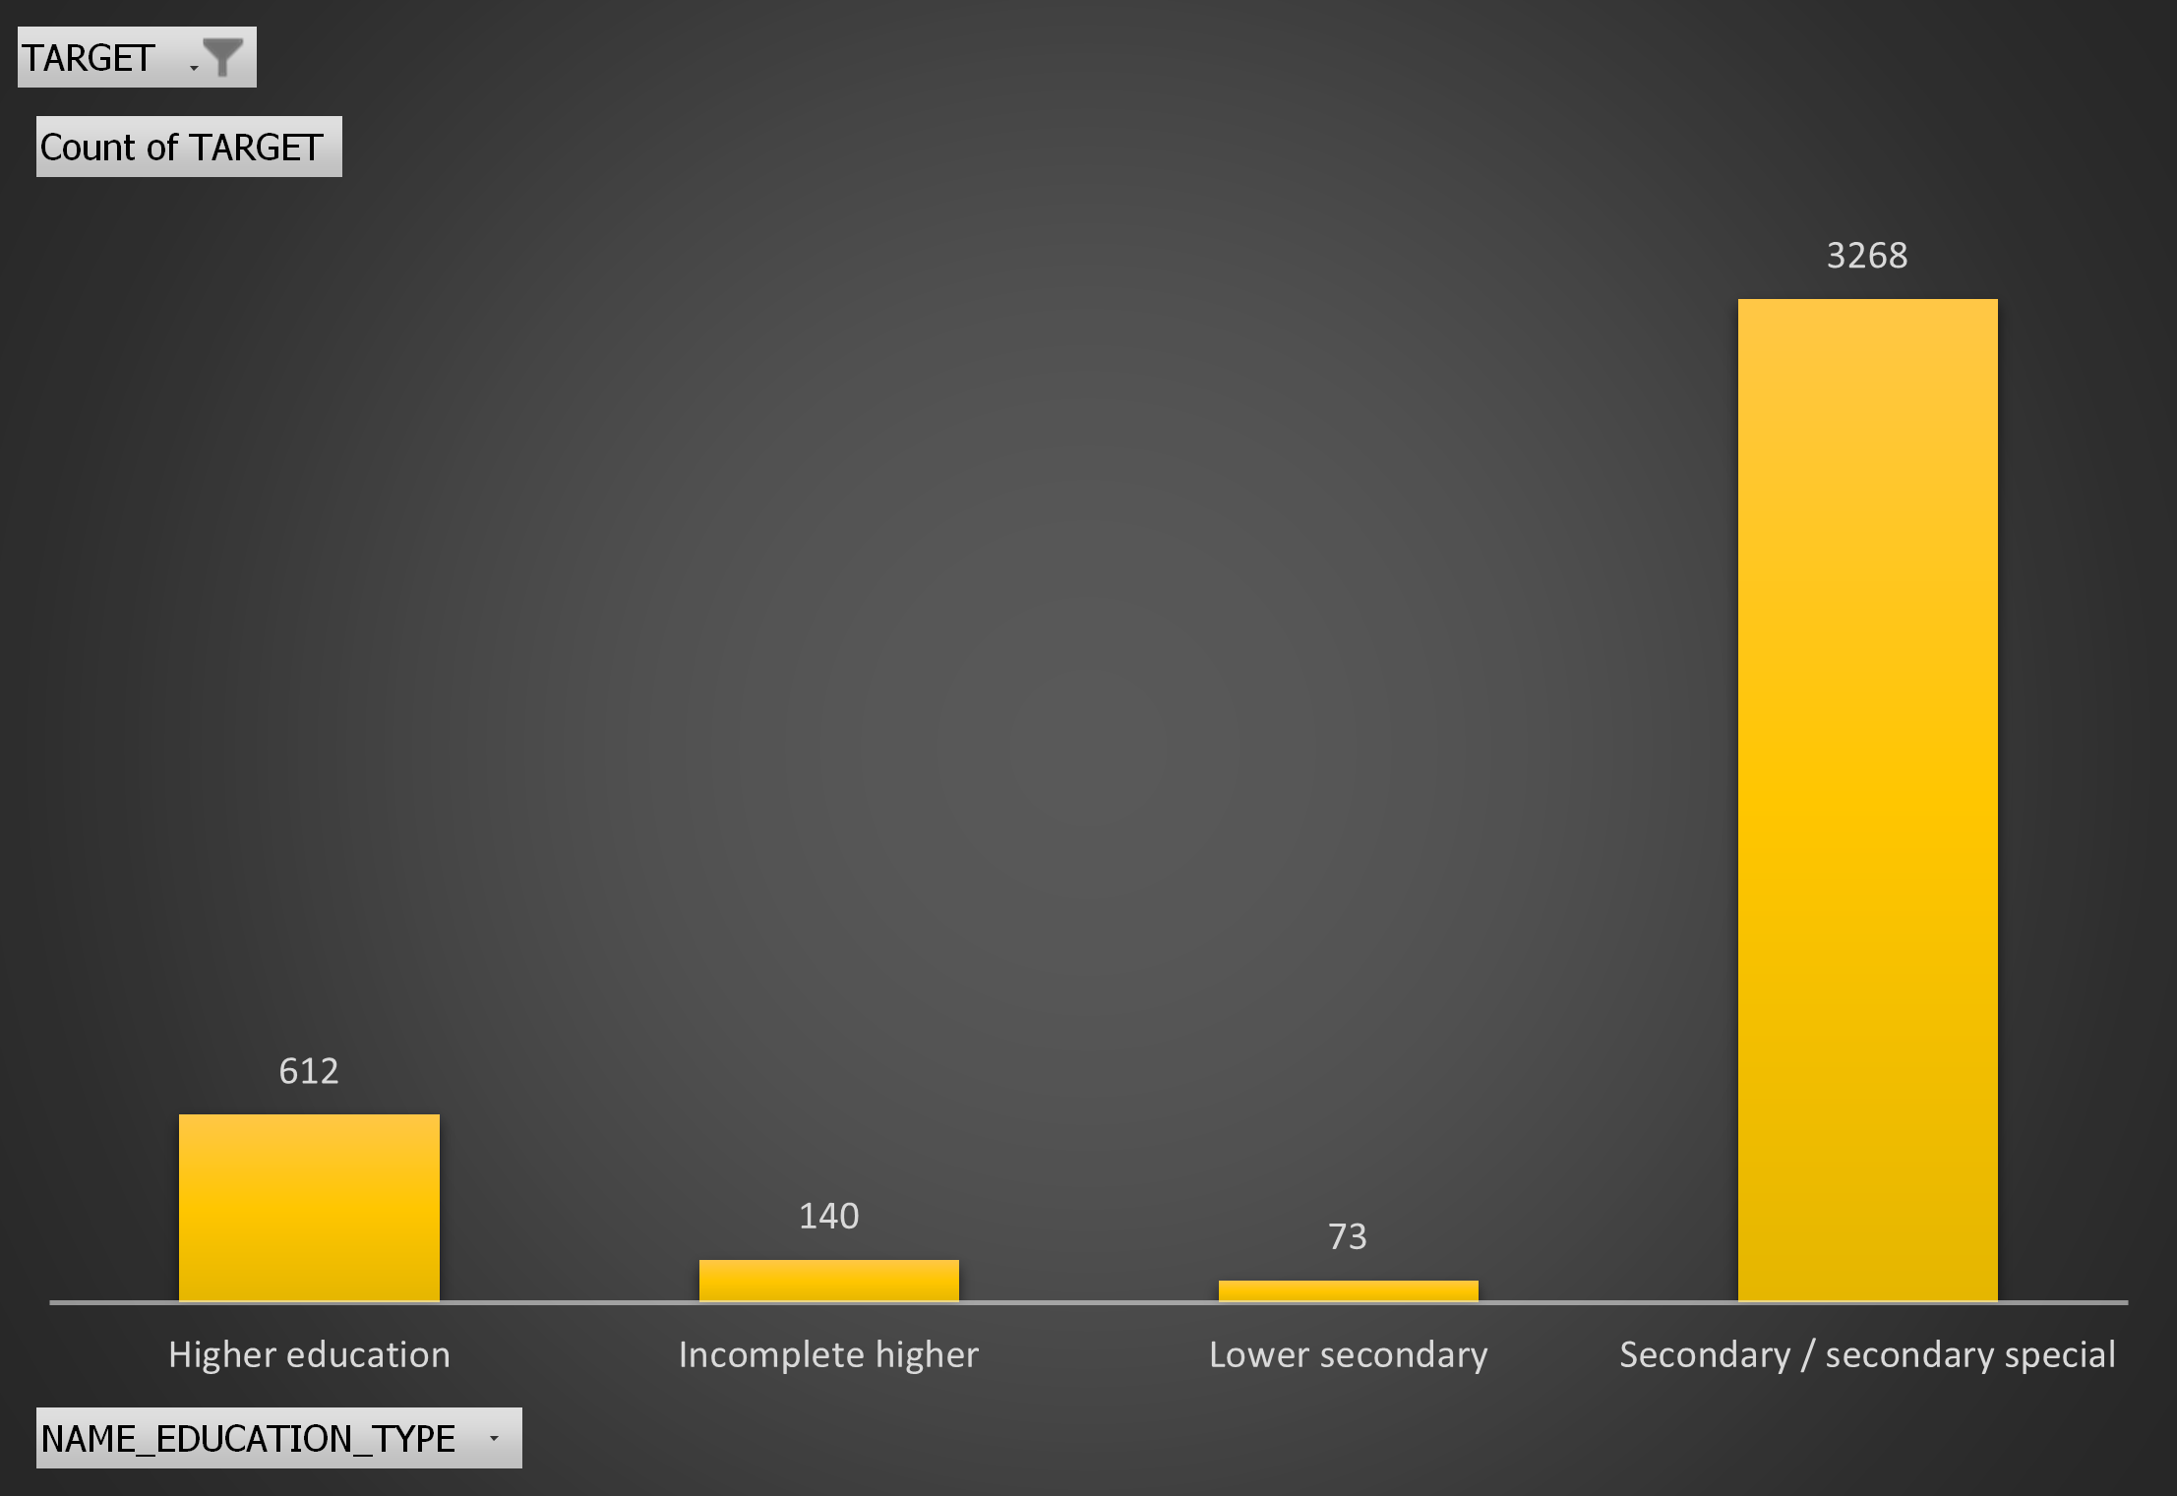
D. Perform Univariate, Segmented Univariate, and Bivariate Analysis
Univariate Analysis
NAME_TYPE_SUITE has the highest count of Unaccompanied.
Females are more defaulters.
Most of the defaulters are working professionals.
Most customers who default have a education till secondary, secondary/special.

Slide 16
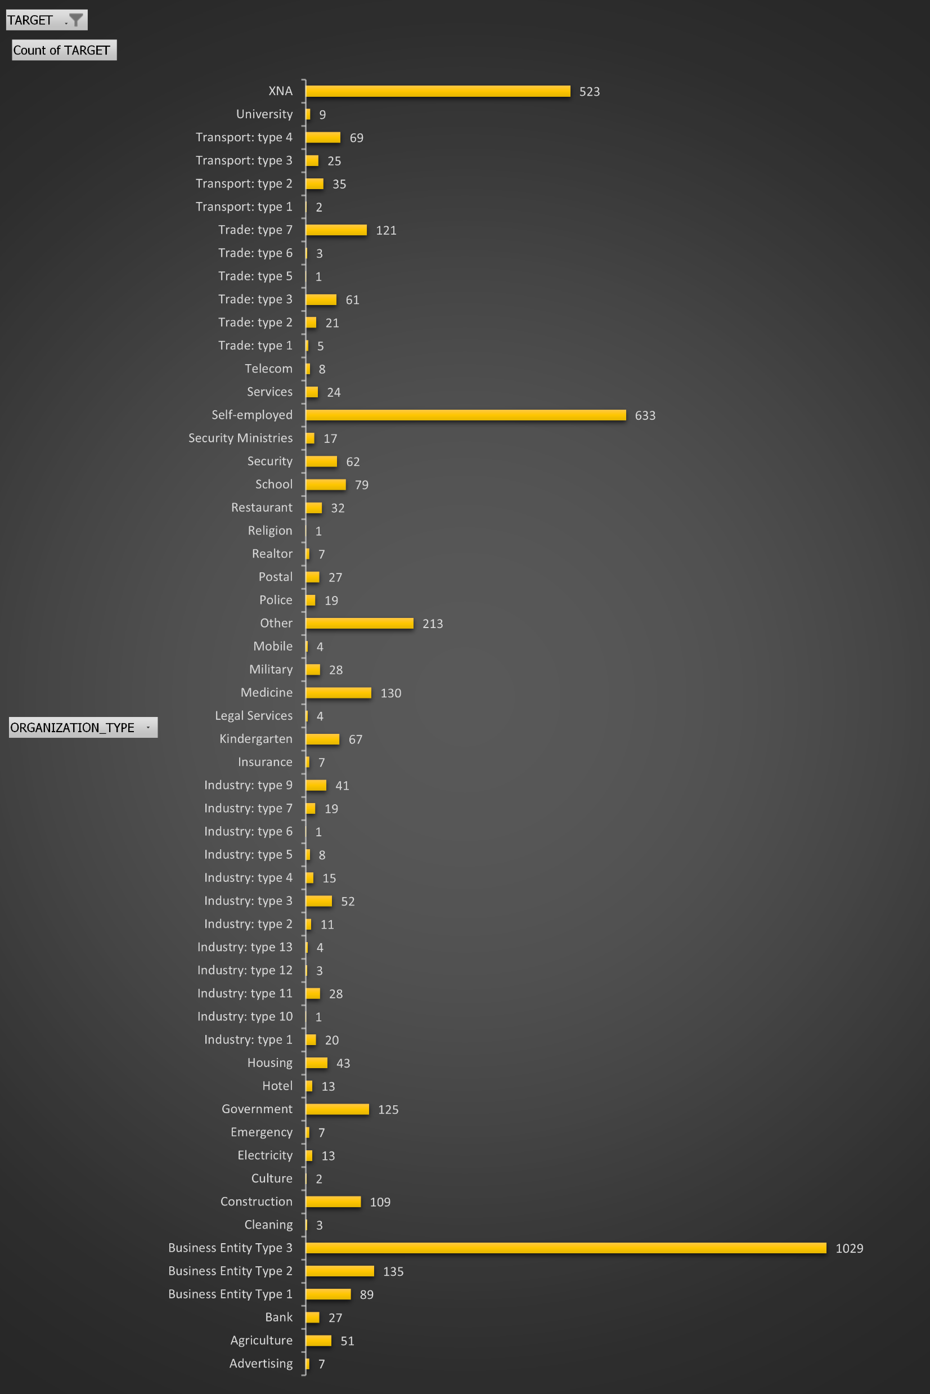
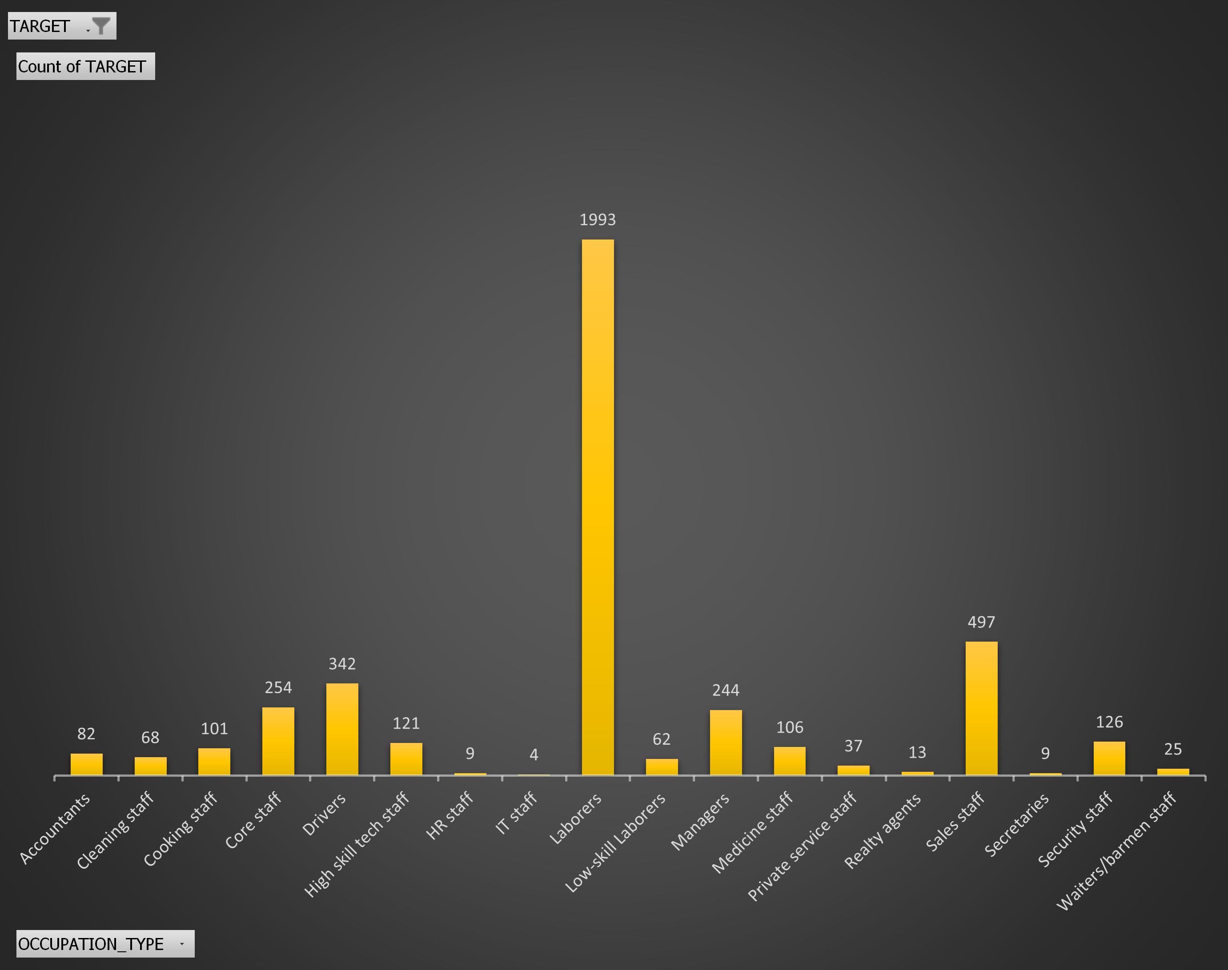
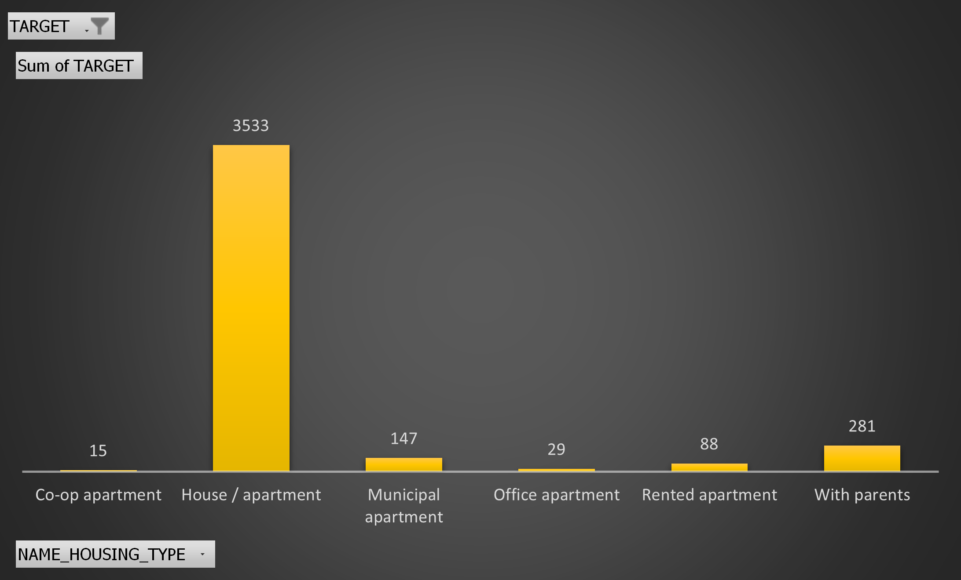
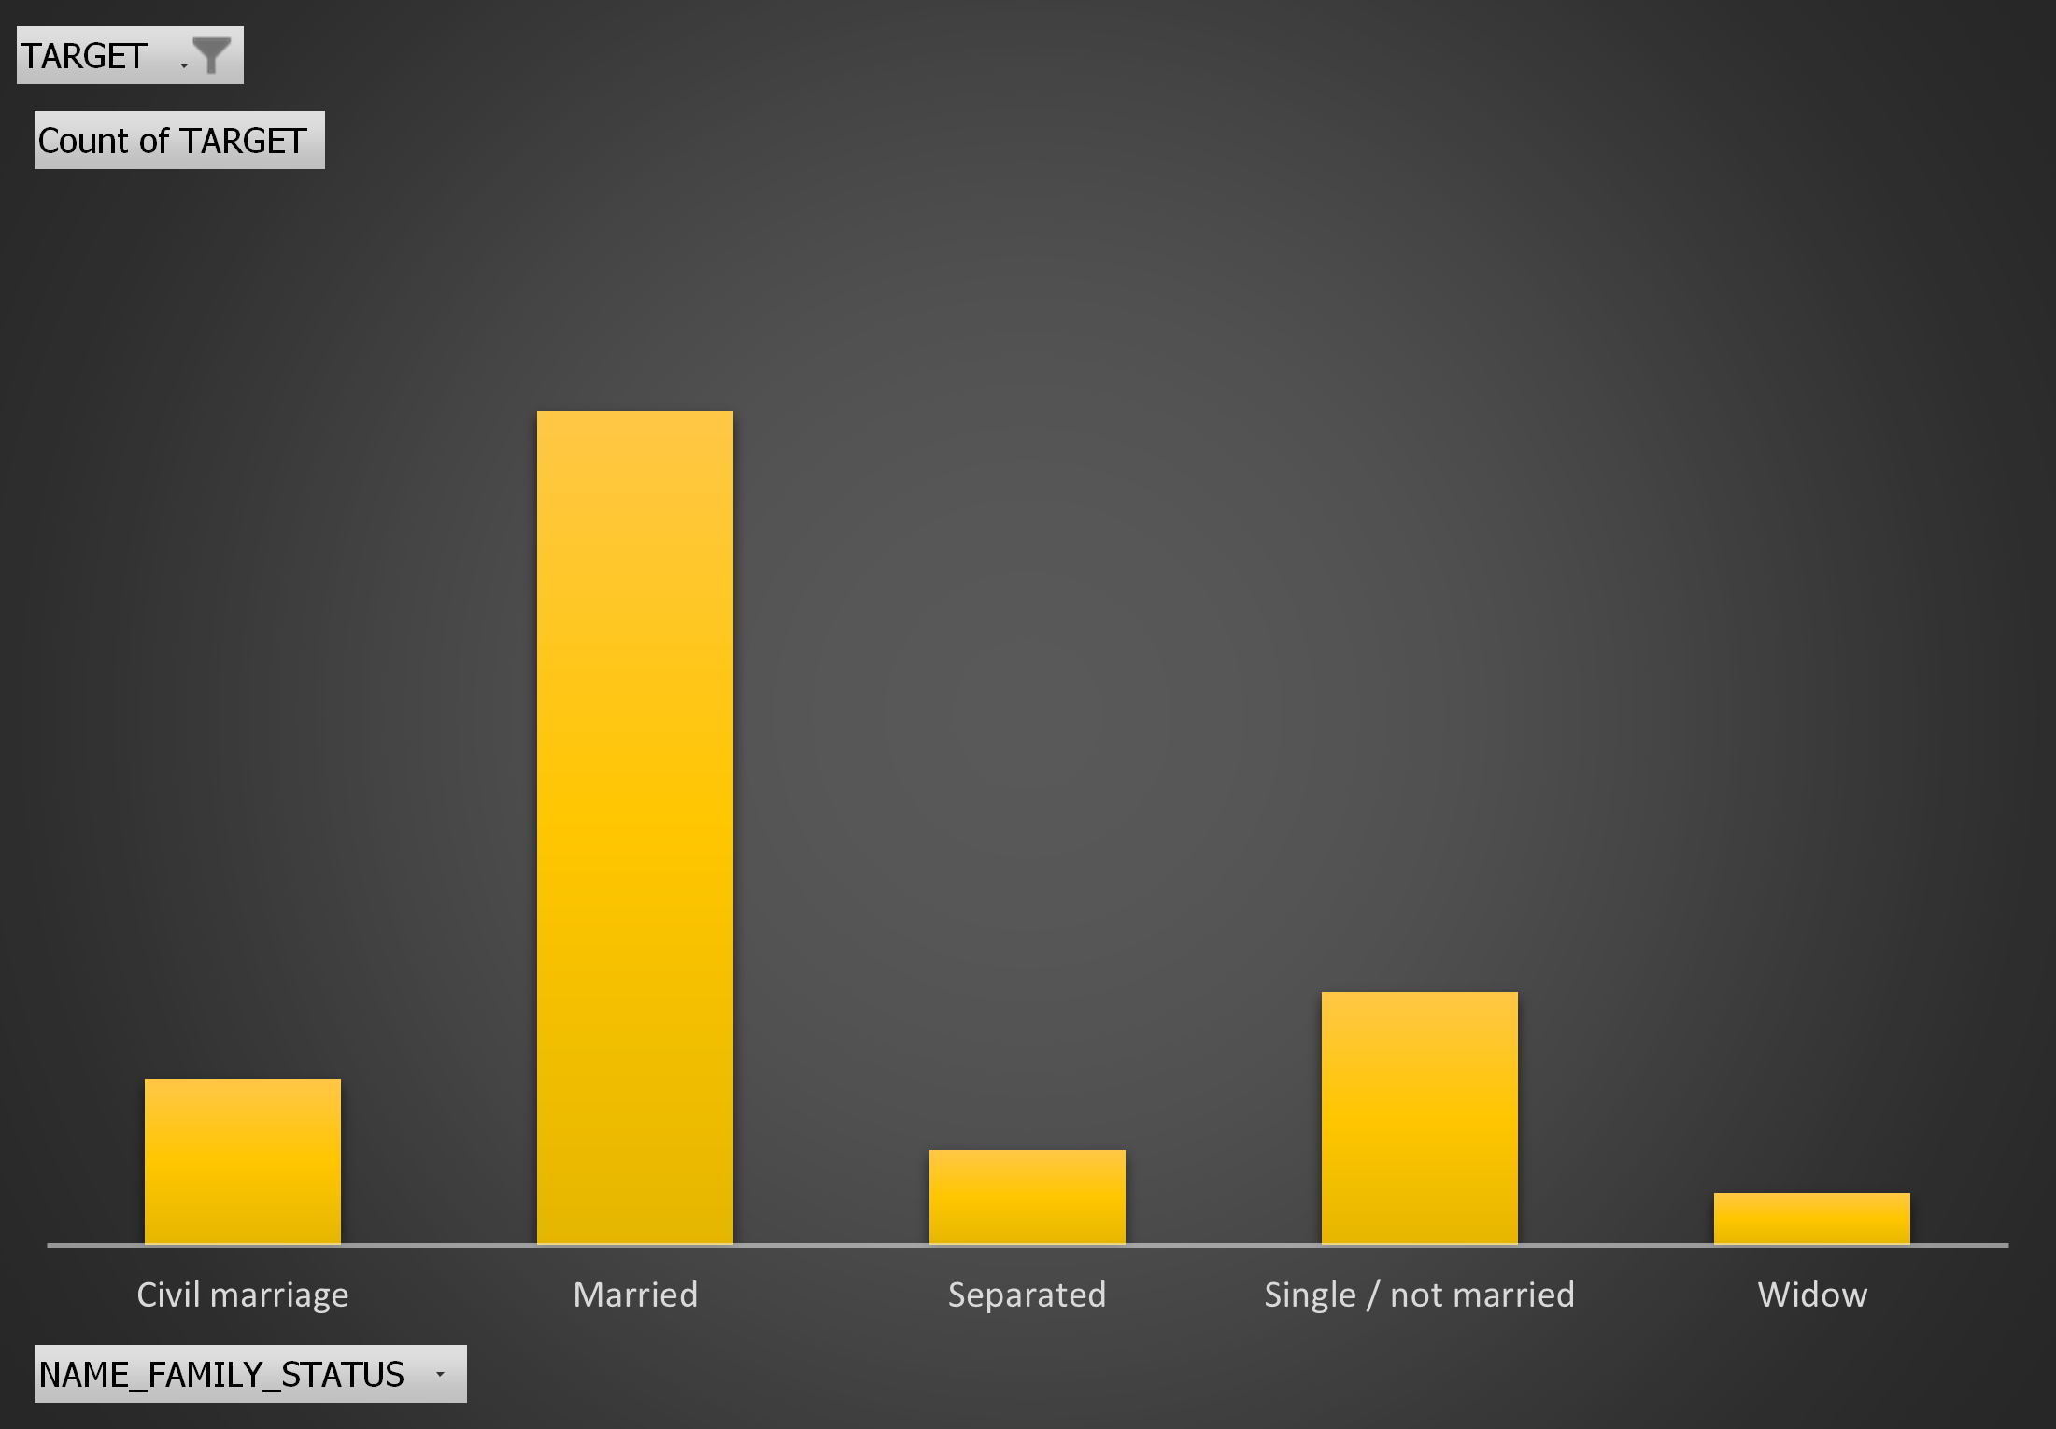
Business Entity Type 3 is the type of organization with most defaulters.
A large number of defaulters are Laborers.
Customers who default lives usually in a house/apartment and are Married.

Slide 17
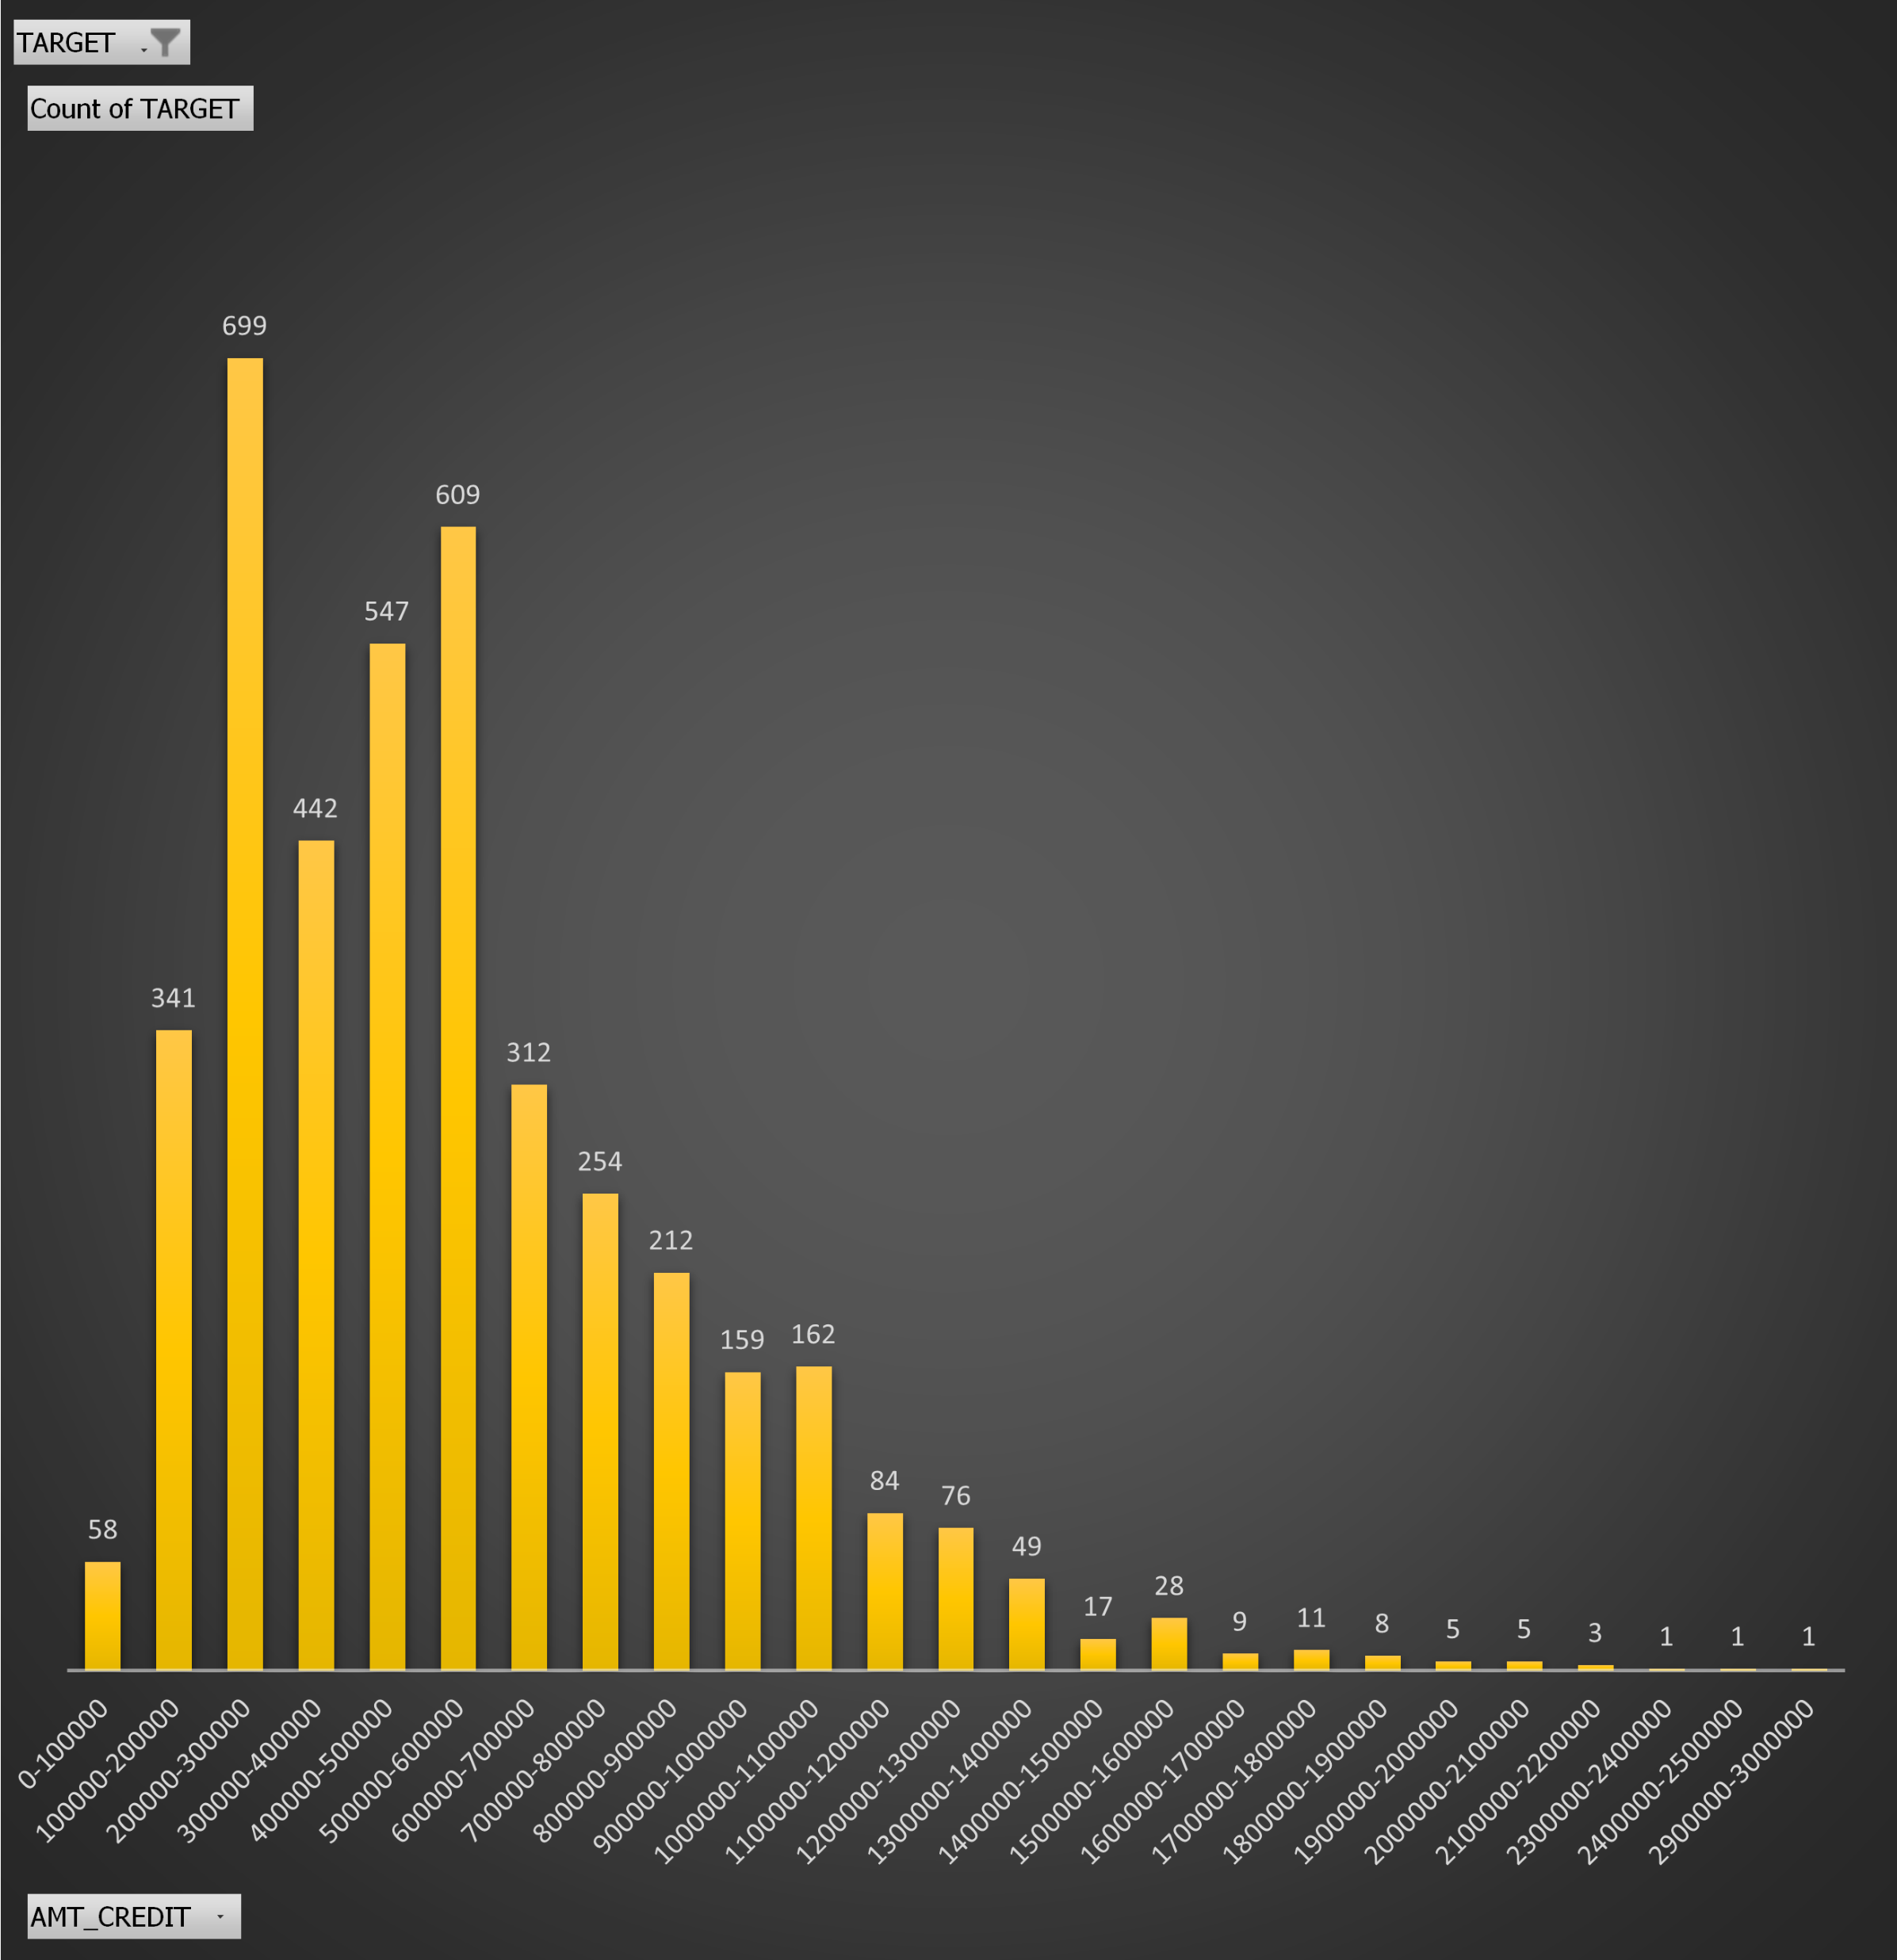
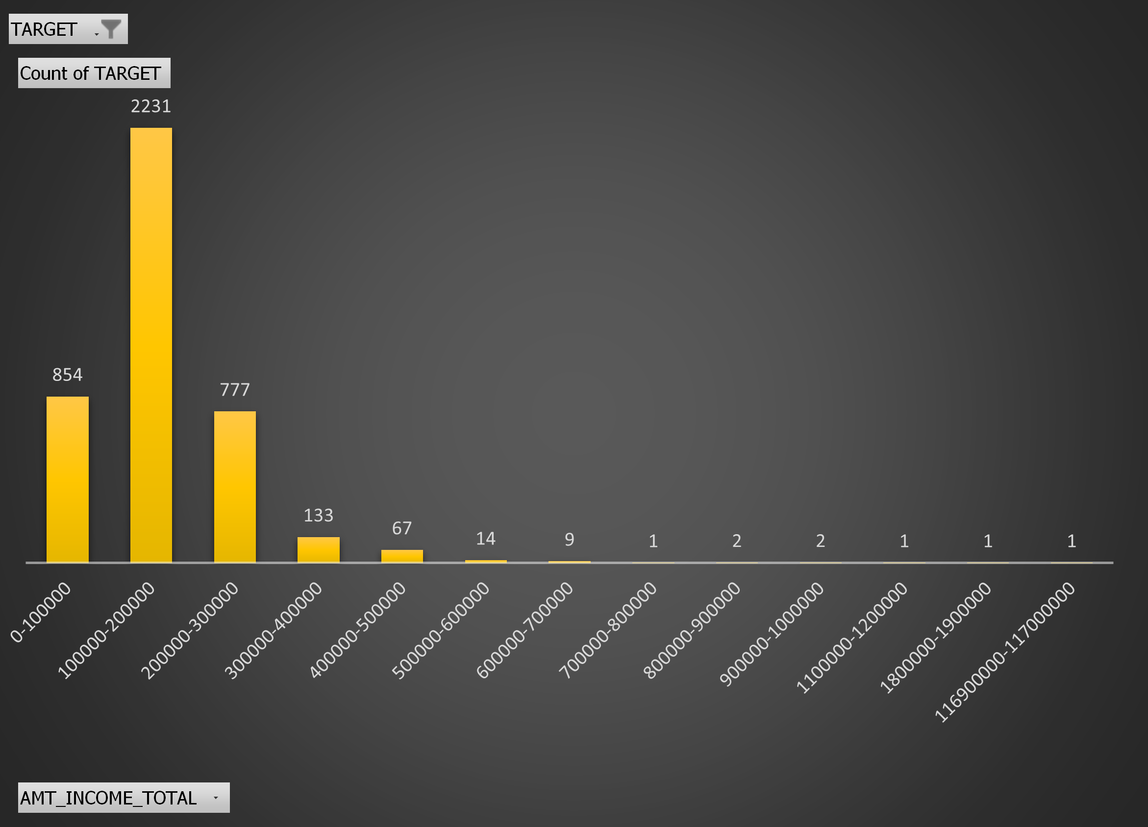
Maximum number of defaulters gets an approved credit limit between 200000-300000
Customers who default mostly earns between 100000-200000

Slide 18
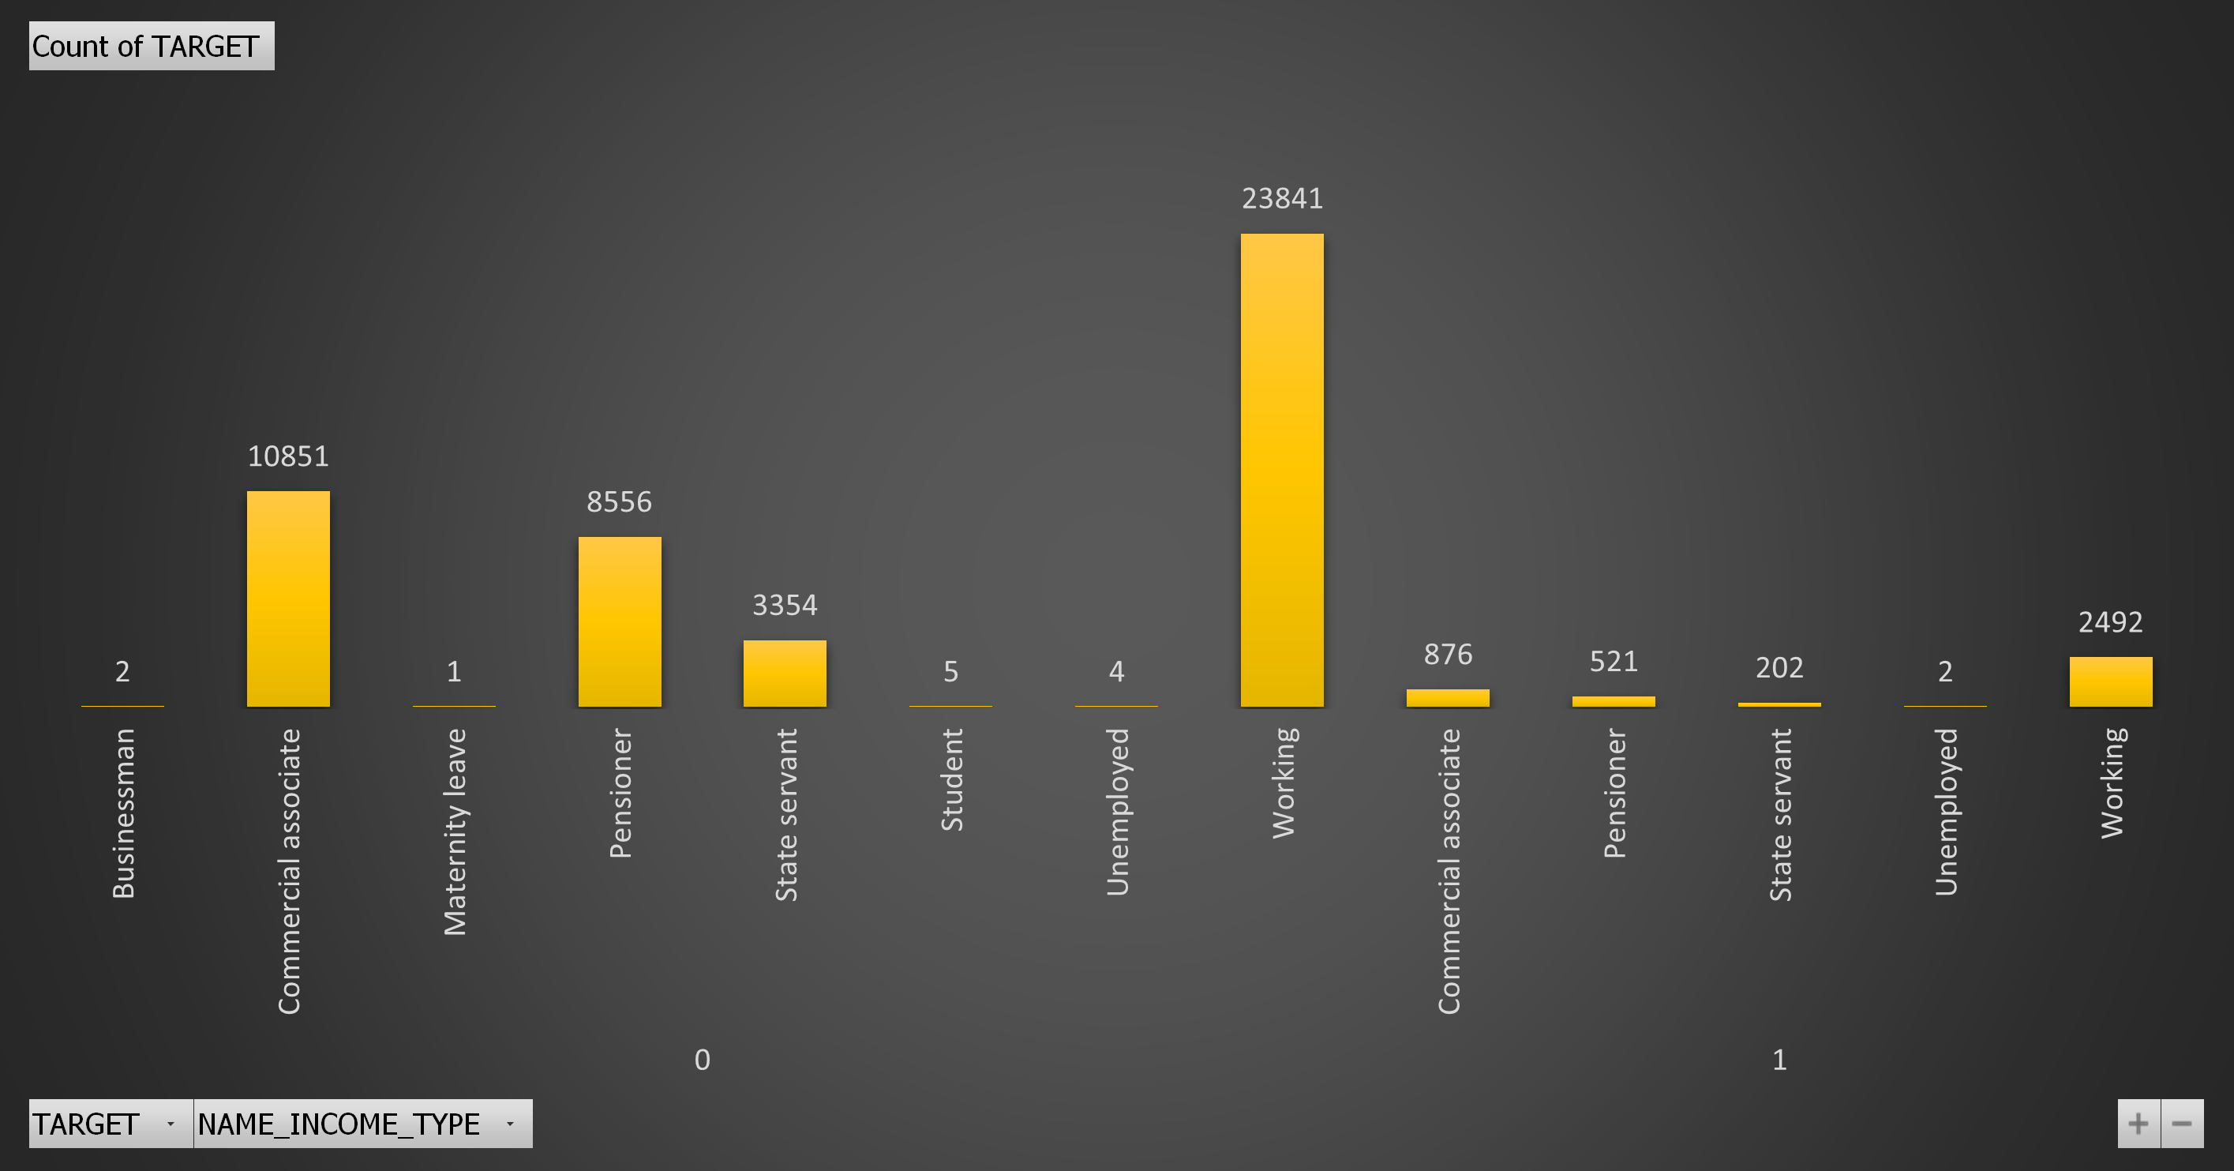
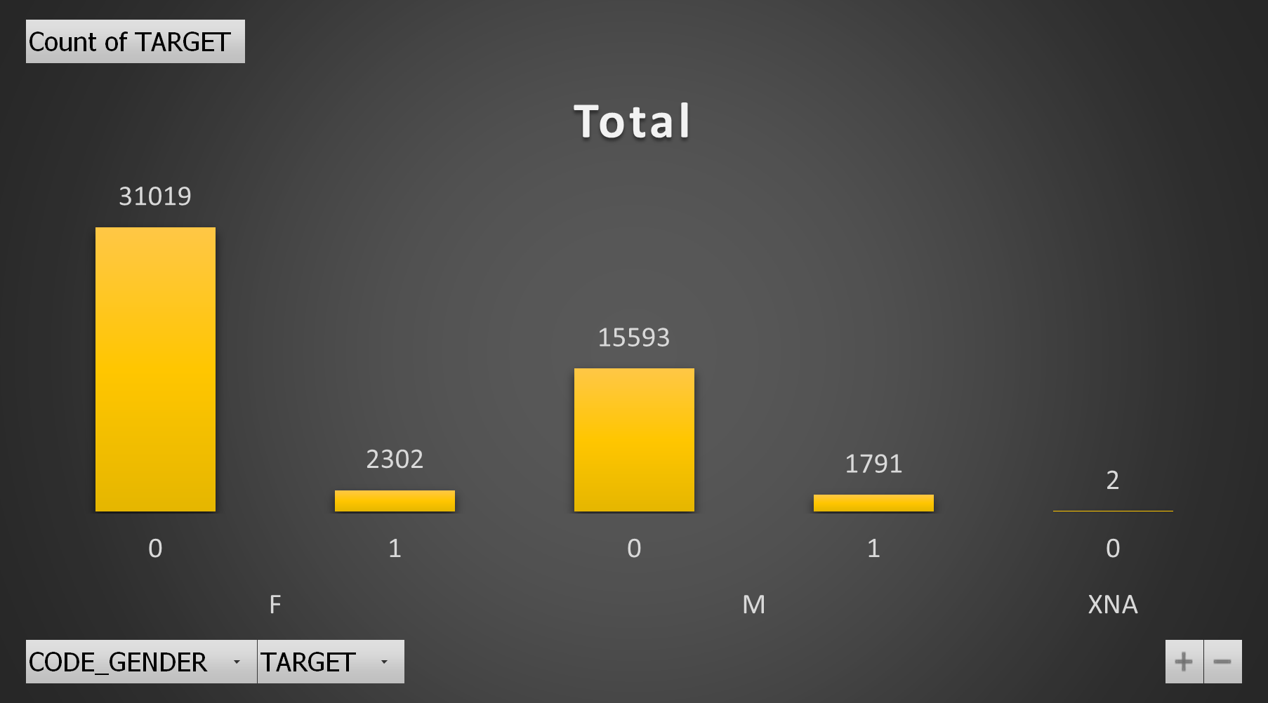
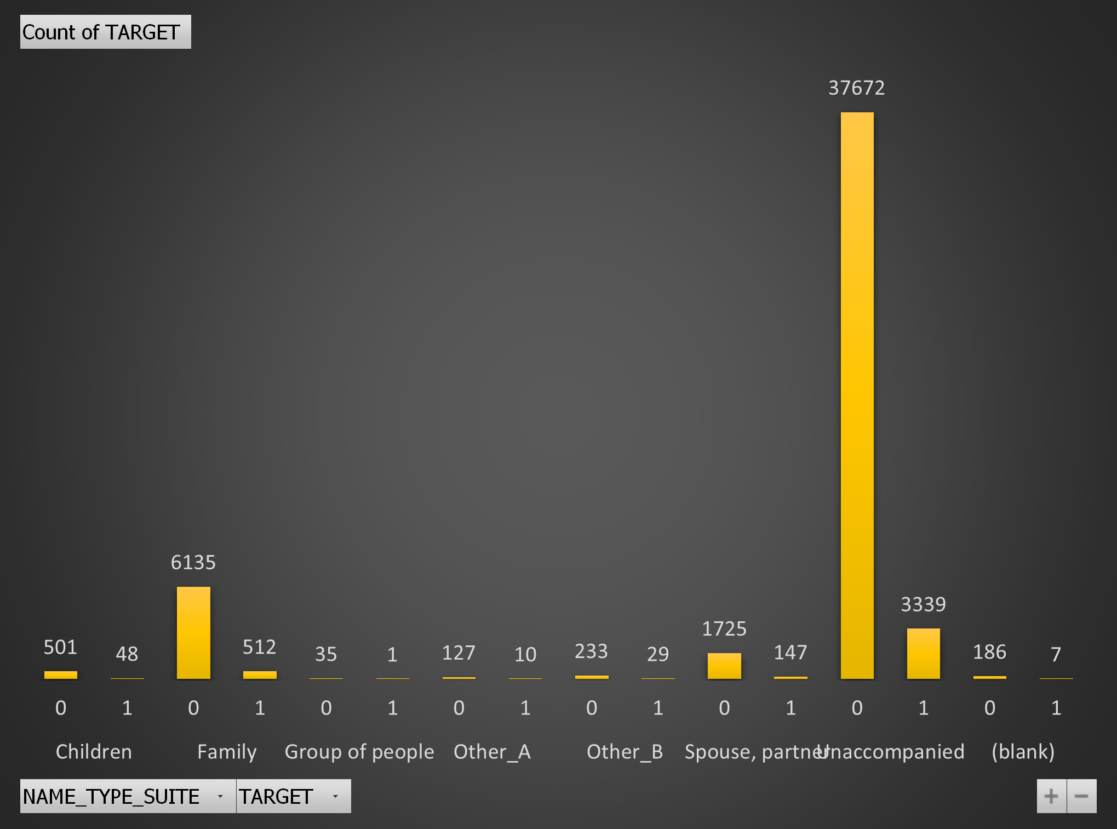
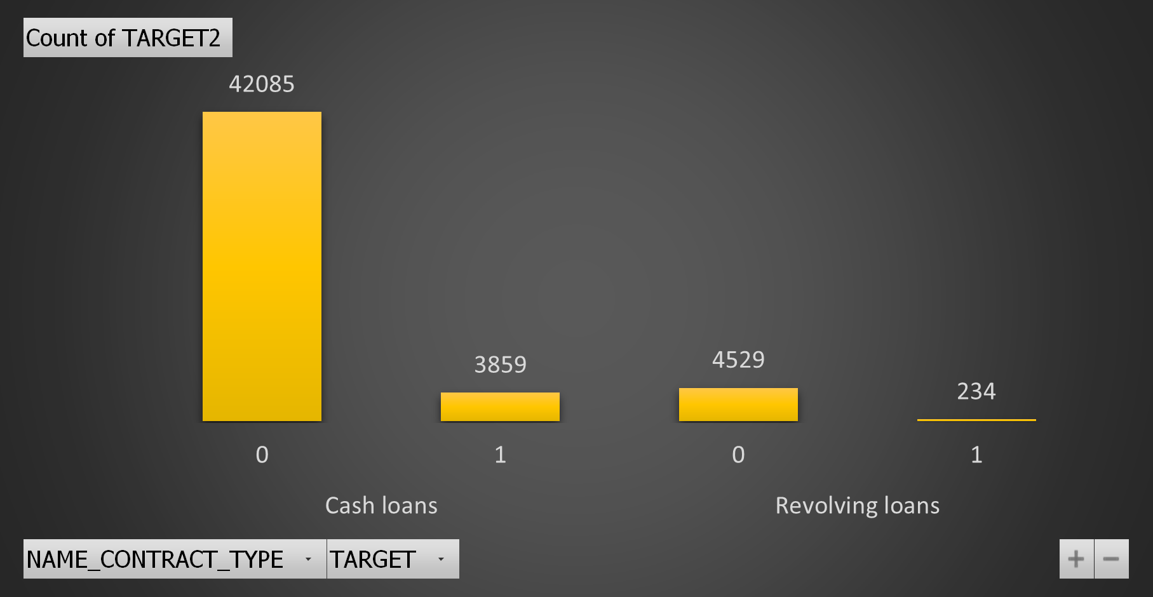
Segmented Univariate Analysis
For Defaulters:
Working professionals mostly default.
XNA most likely defaults.
For Repayers:
Commercial associates and Pensioners are more likely to repay.
Both Males and Females are good repayers.
Cash loans are much in number when compared to revolving loans are it gets repaid more.

Slide 19




For Defaulters:
For every housing_type, there are more defaulters than repayers.
Married people are most likely to default than others.
For Repayers:
Every occupation_type has more repayers than defaulters.
For any education_type, repayers are more than defaulters.

Slide 20



For Defaulters:
Customers who are offered credit limit between 200000-600000 are most defaulters.
Most defaulters are also in the range 100000-200000.
Business Entitiy Type-3 has greater number of defaulters.
For Repayers:
Most repayers are offered credit limit between 200000-300000
People earning in range 100000-200000 mostly repay.
Business Entity Type -3 are better repayers, followed by XNA and Self-employed.

Slide 21



Bivariate Analysis
Average credit amount for customers with income range 700000-800000 is the highest followed by customers in range 1000000-1100000 and 3800000-3900000.
People in the age group 46-51 are offered greater credit amount followed by 51-56,41-46 and 36-41.
Businessmens gets most credit amount followed by maternity leave and state servant.

Slide 22

E. Identify Top Correlations for Different Scenarios :
TOP 10 Correlations for Repayers :
OBS_30_CNT_SOCIAL_CIRCLE-OBS_60_CNT_SOCIAL_CIRCLE
AMT_GOODS_PRICE-AMT_CREDIT
AMT_APPLICATION-AMT_CREDIT.1
REGION_RATING_CLIENT_W_CITY-REGION_RATING_CLIENT
CNT_FAM_MEMBERS-CNT_CHILDREN
LIVE_REGION_NOT_WORK_REGION-REG_REGION_NOT_WORK_REGION
DEF_60_CNT_SOCIAL_CIRCLE-DEF_30_CNT_SOCIAL_CIRCLE
REG_CITY_NOT_WORK_CITY-LIVE_CITY_NOT_WORK_CITY
AMT_ANNUITY.1-AMT_APPLICATION
AMT_GOODS_PRICE-AMT_ANNUITY
We used CORREL() of EXCEL to calculate the correlation coefficients and then ranked them .

Slide 23

E. Identify Top Correlations for Different Scenarios :
TOP 10 Correlations for Defaulters :
FLAG_MOBIL-DAYS_EMPLOYED
OBS_60_CNT_SOCIAL_CIRCLE-FLAG_DOCUMENT_6
AMT_GOODS_PRICE-AMT_ANNUITY
REGION_RATING_CLIENT_W_CITY-REG_CITY_NOT_WORK_CITY
DEF_60_CNT_SOCIAL_CIRCLE-FLAG_DOCUMENT_7
CNT_FAM_MEMBERS-AMT_INCOME_TOTAL
LIVE_REGION_NOT_WORK_REGION-DEF_30_CNT_SOCIAL_CIRCLE
LIVE_CITY_NOT_WORK_CITY-DAYS_LAST_PHONE_CHANGE
AMT_ANNUITY-REGION_POPULATION_RELATIVE
AMT_CREDIT-AMT_GOODS_PRICE

Slide 24
KEY INSIGHTS
SUGGESTIONS
NAME_TYPE_SUITE: people who are unaccompanied default a lot.
CODE_GENDER: Females default more than men.
NAME_INCOME_TYPE: Most of the defaulters are working professionals.
NAME_EDUCATION_TYPE: Most customers who default have a education till secondary, secondary/special.
NAME_HOUSING_TYPE: people living in house/apartment default a lot.
NAME_FAMILY_STATUS: Married people default more.
OCCUPATION_TYPE: Laborers are mostly the defaulters.
ORGANIZATION_TYPE: Business Entity Type 3 is the type of organization with most defaulters.
AMT_INCOME_TOTAL: Customers who default mostly earns between 100000-200000.
AMT_CREDIT: Customers who gets approved credit limit between 200000-300000 are more likely to default.
NAME_CONTRACT_TYPE: Cash loans gets repaid more than revolving loans
Since, customers who has the income range between 100000-200000 are more likely to default so, we can decrease the credit amount of loan taken by them to reduce risk.
Organizations which are business entity type 3 are more likely to default, so, we can have stricter policies for them .
We see a increase in repayment with years of experience and age, so, we can prioritize senior citizens and experienced people.
Since customers who gets approved limit of 200000-300000 are more likely to default, we can increase the rate of interest on such loans .
Strategies should be made to offer more cash loans rather than revolving loans as there are higher chances of them getting repaid.

Slide 25
Result :
While completing the project, I learned how to work with huge datasets. It helped me understand how to merge two datasets and analyze it. The project required extensive use of EXCEL, its formulas and functions, also, discovered how to use add-ins like Data Analysis. In the dataset provided, there were huge amount of missing data, null values, outliers and the project helped me to understand how to deal with them and impute the missing values.

Slide 26
Thank you..!!

